Slide 1
AS Chemistry
Lesson 2 (16/09/2013)
Atomic Structure
Introduction to s,p,d,f notation

Slide 2
Atomic Structure & the periodic table
The model of the atom is useful for understanding lots of ideas in chemistry
But it’s just a model, and the accepted model of the atom has changed throughout history
There have been a number of different models of electronic structure put forward…
Dalton’s & Thomson’s plum pudding model
Rutherford’s atom with a nucleus model
Bohr’s electron shells
We also need to develop the way in which we think about the atom…
HOMEWORK TASK….READ ‘Atomic Models’ sheets

Slide 3
We know….
Electrons orbit the nucleus
Not totally randomly….but in fixed energy levels or shells
Each shell can hold a certain number of electrons…2,8,8,8,8 etc
The shell nearest the nucleus is the lowest energy and is filled 1st
We cannot start a new shell until we fill the one before
Periodic trends/reactivity link with electron number

Slide 4
And it works….
Group 7
Fluorine 9 electrons = 2,7
Chlorine 17 electrons = 2,8,7
Or does it……
Bromine 35 electrons = 2,8,8,8,8,1
We need to rethink…our model has become flawed

Slide 5
Where are the electrons???
Key Words:
Subshells
Orbitals
Principle quantum number
Objectives:
Re think the current model we have for arranging electrons within an atom
Describe electron arrangement using s,p,d,f notation

Slide 6
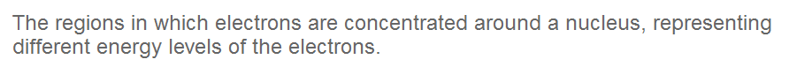
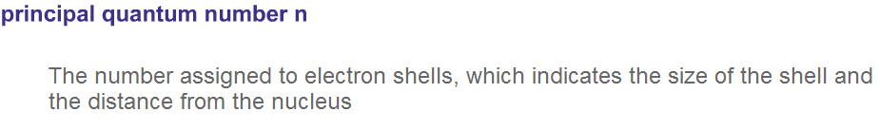
Energy levels & electron shells
Electrons in an atom are arranged in a series of shells or energy levels
Shells:
Each shell ins described by a principle quantum number:

Slide 7
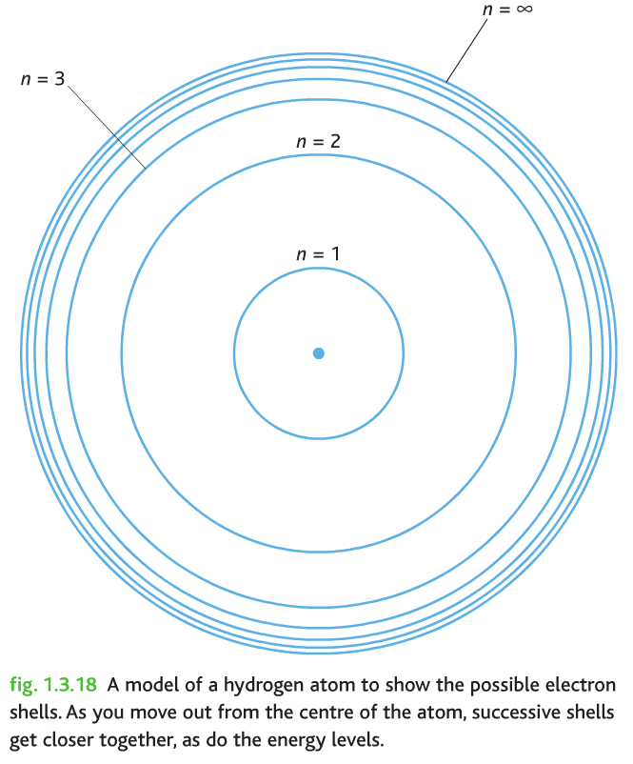
The larger the value of n, the further from the nucleus you are likely to find the electron:

Slide 8
Within each shell or energy level…
We have
Subshells: regions of differing energy within a shell, shown by letters: s, p, d, f, g.
And within these we have differing numbers of orbitals
Within these orbitals we find the ELECTRONS
Their exact position is difficult to pin point
an orbital is defined as an area of space in which there is a high probability of finding an electron.
Each subshell s,p,d,f has a different number of orbitals and a different shape
But an orbital can only hold a maximum of 2 electrons

Slide 9

‘s’ Subshell
Contains 1 orbital
Spherical
Holds a maximum of 2 electrons
Every energy level (or ‘shell’) contains one s-orbital.
They have the lowest energy
Are closet to the nucleus

Slide 10


‘p’ Subshell
Contains 3 orbitals
These are shaped like a 3D figure of eight (dumbell shaped)
Every energy level except the first level contains three p-orbitals
Each p-orbital in the same energy level has the same energy but different orientations: x, y and z.
A p-orbital in the second energy level is a 2p orbital (2px, 2py, 2pz)
3 orbitals….each hold a max of 2 electrons…p subshell can hold a total of 6 electrons

Slide 11
‘d’ subshells have 5 orbitals so can hold a max of 10 electrons
‘f’ subshells have 7 orbitals so can hold a max of 14 electrons
From now on you must show how the electrons are arranged using s,p,d,f notation…..
To be continued….

Slide 12
