Slide 1
AS Chemistry
Lesson 4 (24/09/2013)
Ionisation Energy
Trends across periods & down groups

Slide 2
Trends in the Periodic Table
Key Words/Ideas:
Ionisation energy
Nuclear Charge (NAF)
Distance from nucleus
Shielding
Outcomes:
Understand and describe & explain the trends in the periodic table both down a group & across a period
Explain trends in ionisation energy based on given data for trends down a group & across a period
Write equations to show ionisation energies

Slide 3
Ionisation Energy
(1st) Ionisation energy: The amount of energy required to remove 1 mole of electrons from 1 mole of atoms in their gaseous state
Can be written in equation form
O_{(g)} → O+_{(g)} + e-
(2nd) Ionisation energy: The amount of energy required to remove 1 mole of electrons from 1 ions of atoms in their gaseous state
Can be written in equation form
O⁺_{(g)} → O²⁺_{(g)} + e-

Slide 4
Factors Affecting Ionisation Energy
Then more tightly held the outer electrons, the higher the ionisation energy
Nuclear charge: the attractive force between the positive protons in the nucleus and the negative electrons in the energy levels. The more protons, the greater the nuclear charge.
Shielding: Inner electrons tend to shield the outer electrons from the attractive force of the nucleus. The more energy levels between the outer electrons and the nucleus, the more shielding.
Distance from the Nucleus: The further away the electron being removed is from the nucleus, the weaker the attraction between the negatively charged electron and the positively charged nucleus is.

Slide 5
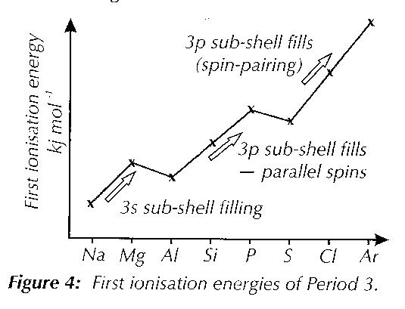
Ionisation Energy & Periods:
Across a period

Slide 6
Across Periods
Ionisation energy increases across a period
  It becomes harder to remove an electron
This is because:
Increasing positive nuclear charge across the period: Without the addition of extra electron shells to screen the outer electrons. Electrons are added to the same area in space so there is a stronger attraction between them and the positive protons as you go across a period.
The atomic radius gets smaller: So electrons are closer to the nucleus and held more firmly – so it requires more energy to make ionisation happen
The end of each period is marked by the high ionisation energy of a noble gas – this is a result of a stable electronic structure & indicates their unreactive natures

Slide 7
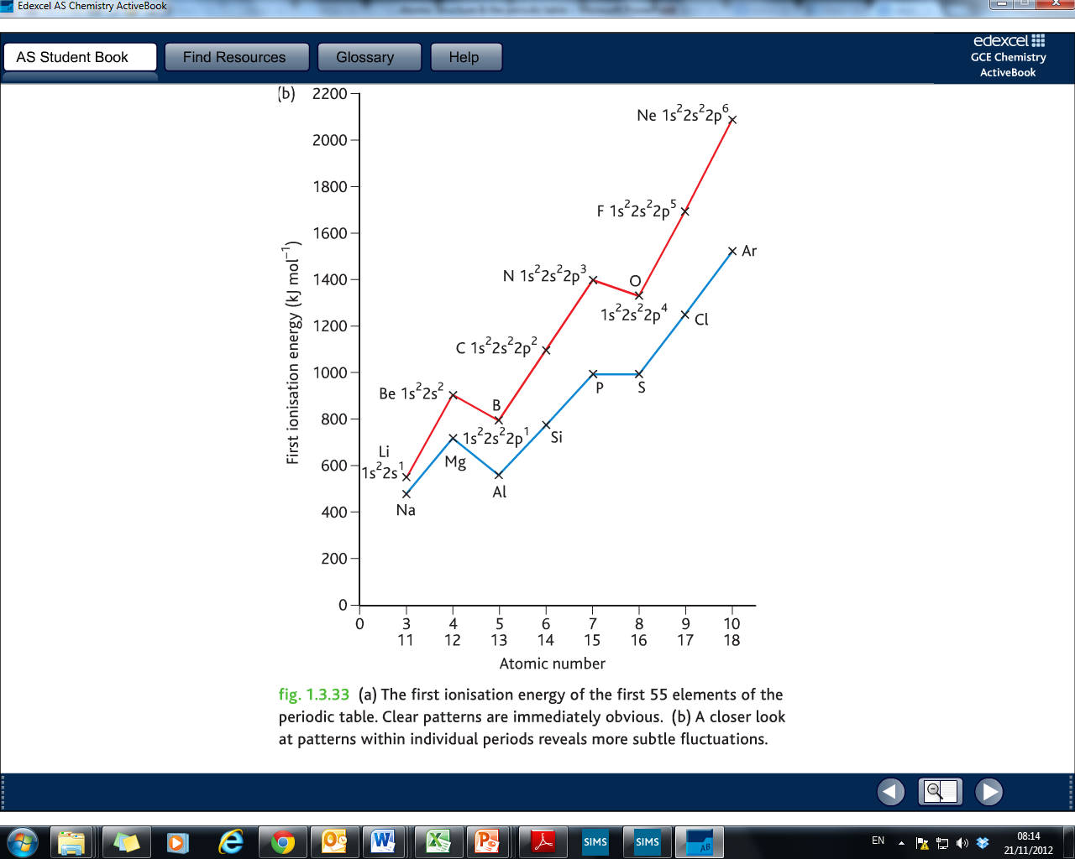
Ionisation Energy Across Period 2
Ionisation Energy Across Period 3

Slide 8
Now Try…..
First ionisation energies do not increase smoothly across a period. Using spdf notation explain:
Why is the first ionisation energy of Be is larger than B
Mg has a larger first ionisation energy than Al – why?
  For Be or Mg, an electron must be removed from a full s-shell.
  Full subshells are particularly stable – so it requires more energy than removing a single p electron from B or Al

Slide 9
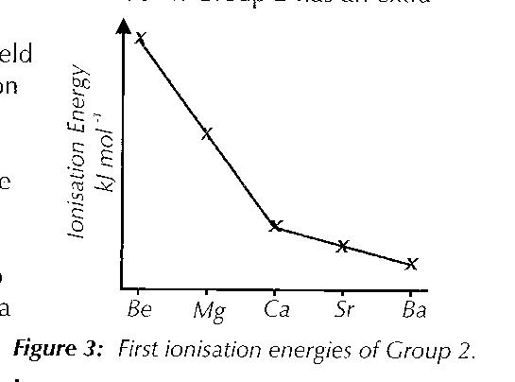
Ionisation Energy & Groups:
Down A Group

Slide 10
Down Groups
Ionisation energy DECREASES down a group
  It becomes easier to remove an electron
This is because:
Decrease in positive nuclear charge across the period: With the addition of extra electron shells to screen the outer electrons. There is a weaker attraction between them and the positive protons as you go down a group
The atomic radius gets bigger: So electrons are further away from the nucleus and held less firmly – so it requires less energy to make ionisation happen

Slide 11
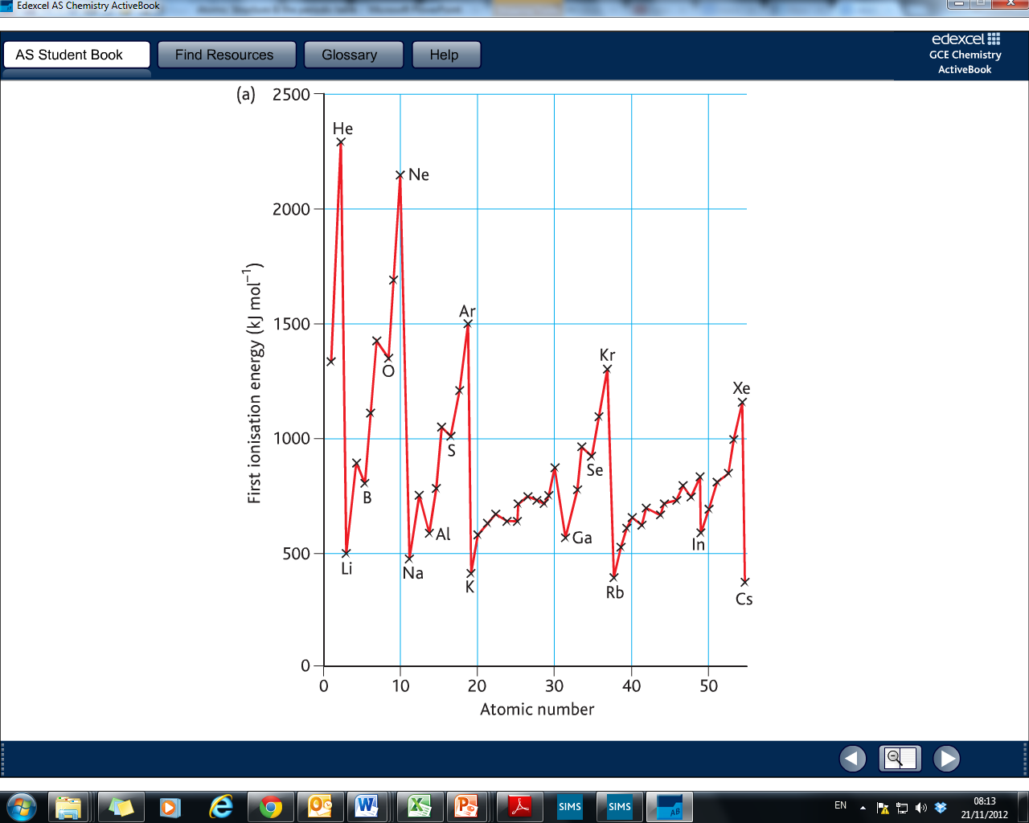

Slide 12
Now Try…….
Nitrogen & phosphorous have unexpectedly high first ionisation energies. Write out their spdf notation and use this to explain why this happens.
A.
  They both have a half-full outer p subshell.
  Half full subshells seem to have greater stability
  So requires more energy

