Slide 1
AS Chemistry
Lesson 3 (19/09/2013)
s,p,d,f notation continued
Writing electronic configuration using s,p,d,f notation

Slide 2
Orbitals & shells
Key Words:
Electron spin
Electronic configuration
Objectives:
Electrons spins & filling orbitals

Slide 3
Using ‘boxes’:Electron Spin
Electron Spin: the rotation of electrons clockwise or anticlockwise creating a magnetic field
An electron can spin either clockwise or anticlockwise – and because it is moving, it creates a magnetic field
This can be represented by using a small arrow
( ) or ( ) – so showing spins in opposite directions

Slide 4
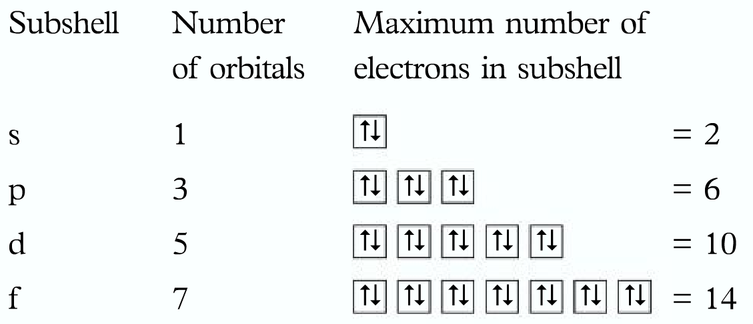
2 electrons in the same orbital cannot have the same spin
This means each orbital can have a maximum of 2 electrons, having opposite spins

Slide 5
Using s,p,d,f notation
Electronic configuration: the arrangement of electrons in an atom in their subshells and orbitals
Easy if you follow a few simple rules:
Lowest energy sub-shells are filled 1st
(Use help sheet-Hunds Rule)
s then p then d then f
2. You cannot start to fill a new sub-shell until the sub-shell before it holds the max number of electrons it can
3. Each orbital within the sub shell fills singly before doubling up on electrons
Eg/ Nitrogen / Oxygen

Slide 6
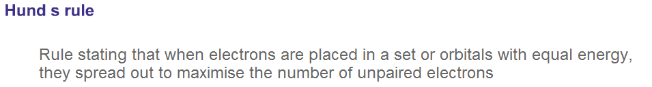
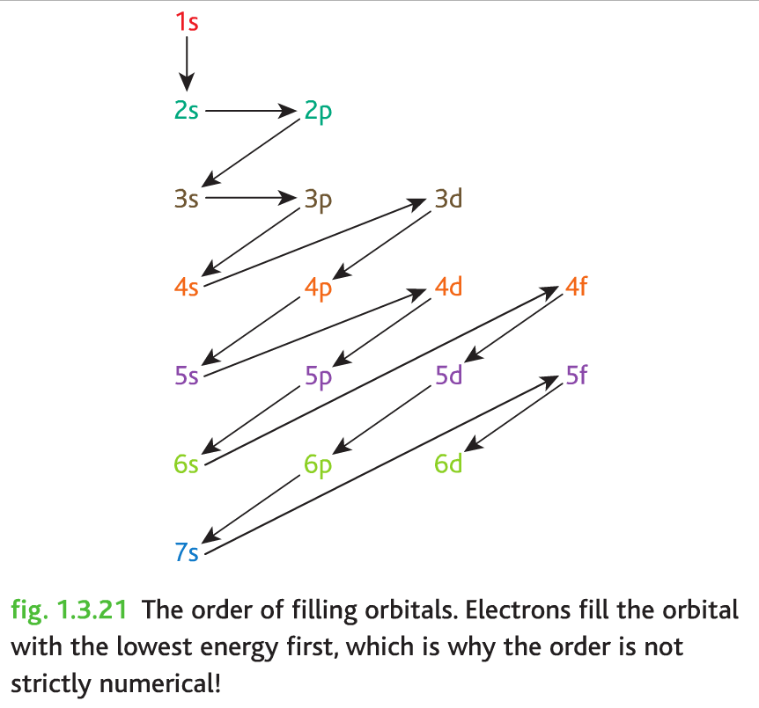
Hund’s Rule

Slide 7
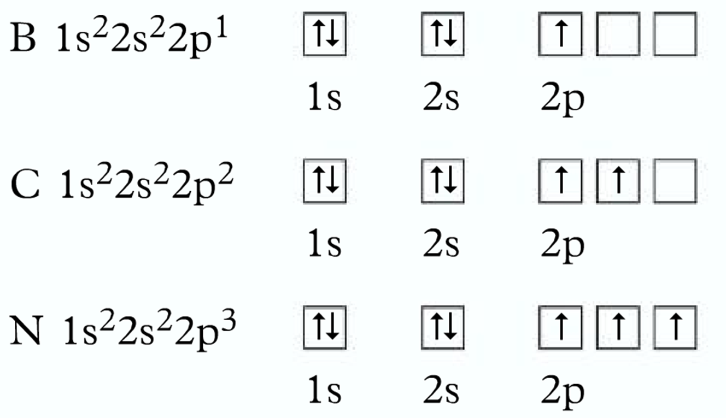
Note: the empty p orbitals are shown.
It doesn’t matter which 2p orbital is filled first as they all have the same energy

Slide 8
Writing electronic configurations for ions:
For an ion: you simply add or subtract the right number of electrons from the outer shell
Remember Hund’s Rule when removing electrons: one electron comes out of each completely filled orbital in the outer shell before any unpaired electrons and removed.
E.g: O²⁻ is: 1s²2s²2p⁶

Slide 9
All the elements in a period have the same number of electron shells.
So, the elements in each group and period show particular characteristics and trends in their chemical and physical properties
Periodic Law: the properties of the elements are a function of their atomic numbers

Slide 10
Blocks
Block | Groups | Subshell:
s | 1 + 2 | Outer electrons in s subshells
p | 3+4+5+6+7+0 | Outer electrons in p subshells
d | Transitional metals | Outer electrons in d subshells
f | Lanthanides + actinides | Outer electrons in f subshells

