Slide 1
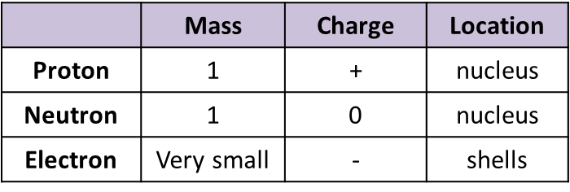
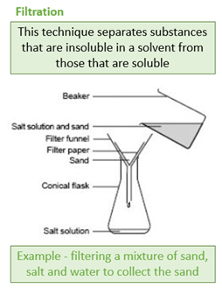
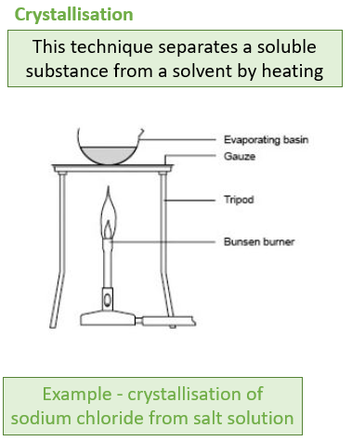
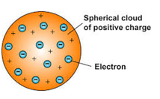
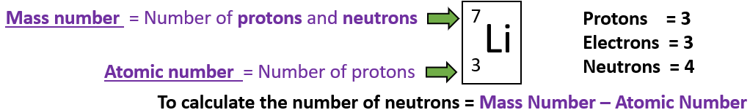
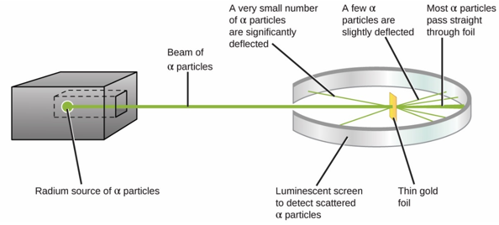
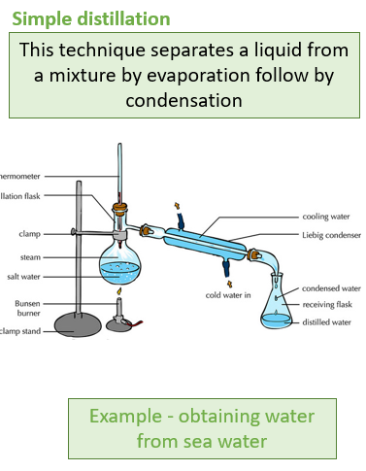
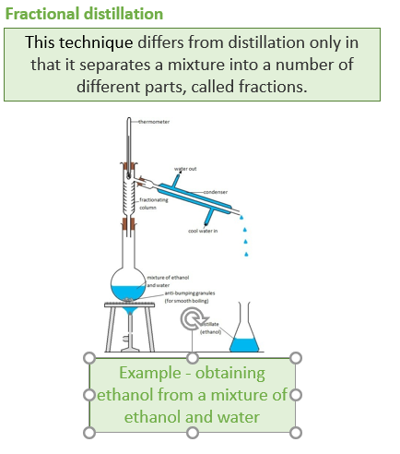
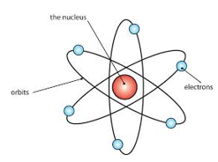
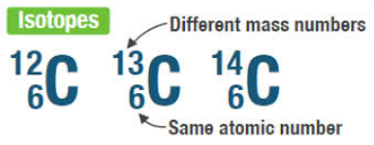
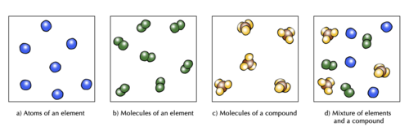
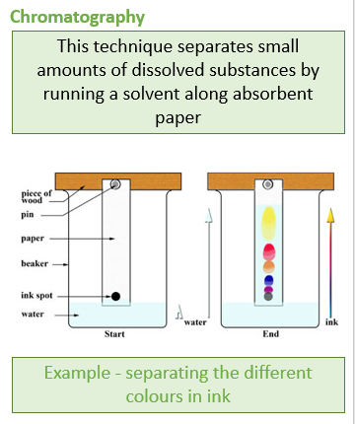
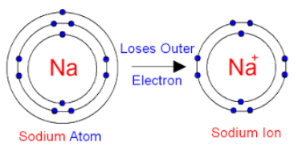
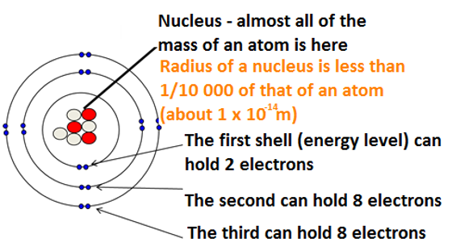
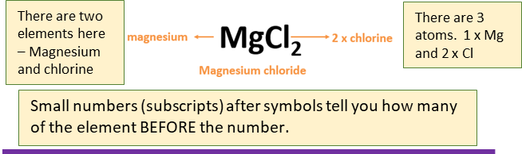
Atoms, elements and compounds
Separating mixtures
GCSE Atomic Structure
Development of Atomic Model
Subatomic Particles
A mixture consists of two or more elements or compounds not chemically combined together.
Dalton – atoms can’t be divided
All substances are made of atoms that cannot be chemically broken down. It is the smallest part of an element.
Elements are made of only one type of atom. Each element has its own symbol.
e.g. Na is sodium.
JJ Thompson discovered electrons – Plum pudding model
Number of protons(+) = Number of electrons (-)
Number of neutrons =
mass number – atomic number
Compounds contain more than one type of atom.
Naming compounds-
Two elements = ide
e.g. Na₂S Sodium sulphide
Two or more including oxygen = ate
e.g. Na₂SO₄ = sodium sulphate
Geiger-
Marsden The Nuclear Model of the Atom
Bohr – electrons in shells
Atoms lose or gain electrons to form ions
Chadwick – the neutron
Atomic radius
= 0.1nm
1nm = 1x10⁻⁹m

