Slide 1
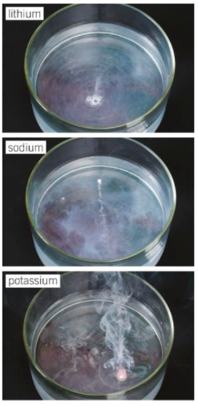
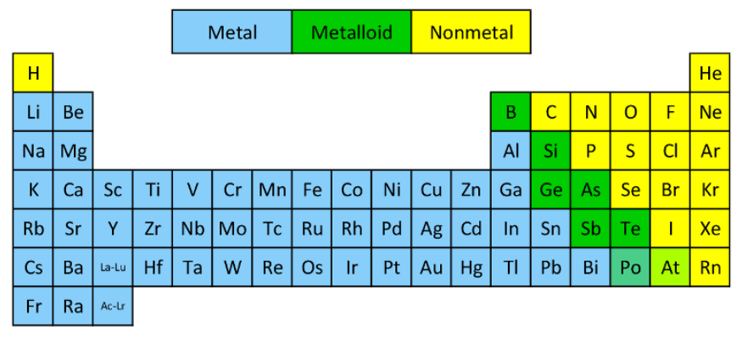
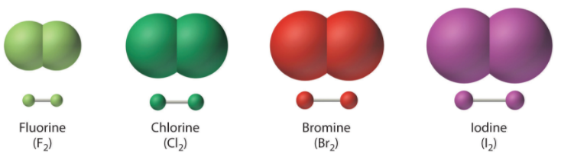
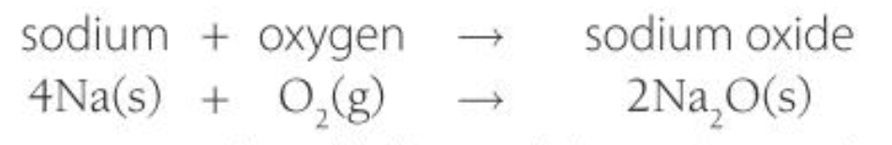
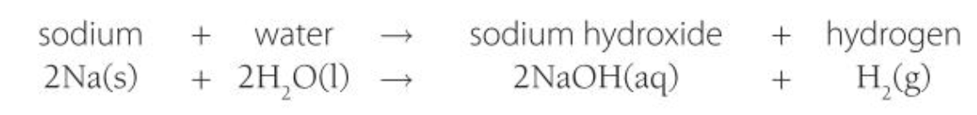
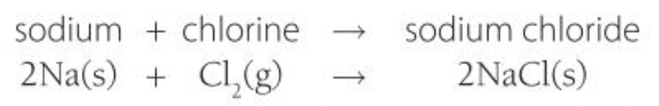
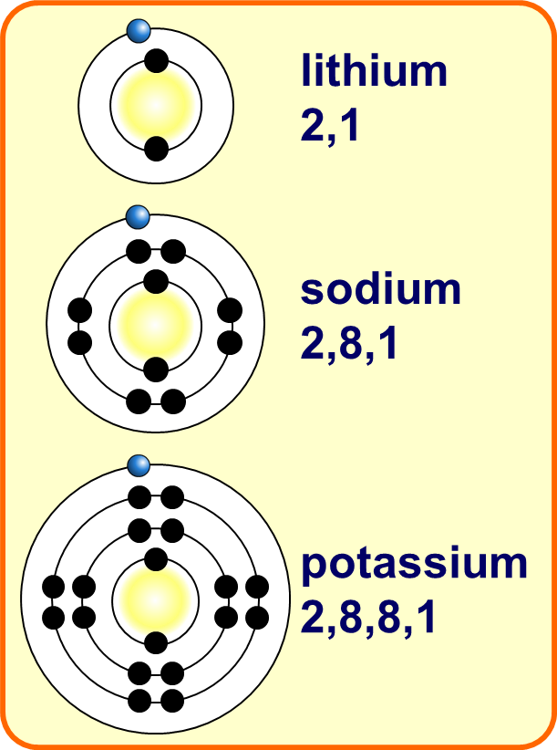
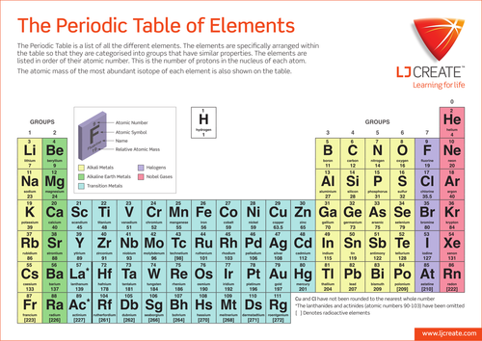
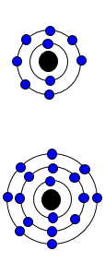
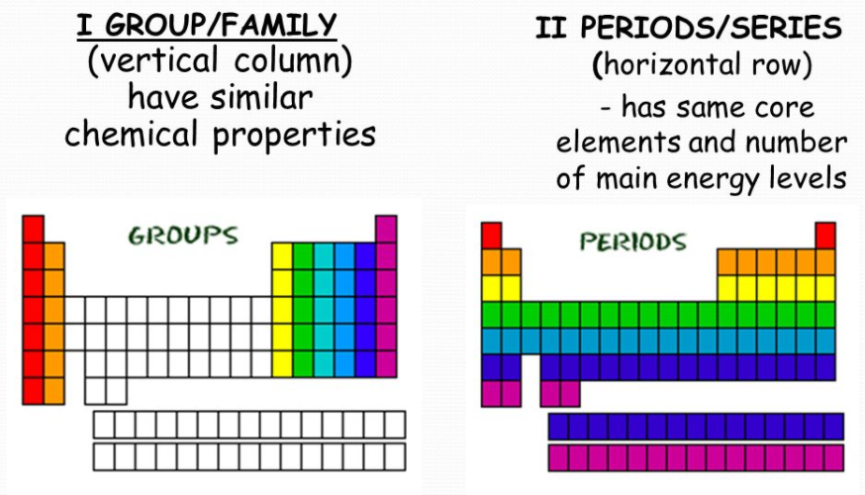
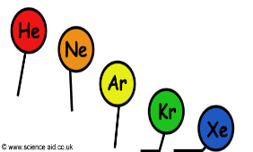
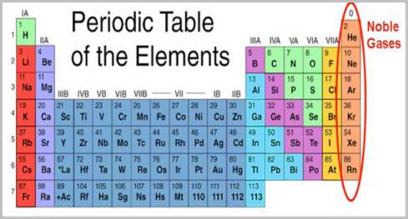
History
Periodic Table
Group 1
Group 7
Metals vs Non-metals
Early periodic tables arranged in order of atomic weight
Non-metals: Many electrons in outer shell so form negative ions.
Low melting and boiling points.
Alkali Metals
Very reactive (due to single electron in outer shell)
Halogens
Very reactive (due to having 7 electrons in outer shell)
☹ Some elements were in the wrong groups so didn’t follow the pattern
Metals
React with oxygen to form oxides
React with water to form the hydroxide and hydrogen
React with chlorine to form chlorides
Non- metals
Exist in pairs as molecules (diatomic molecules)
React with metals to form white solid crystals
React with non-metals to form small molecules
Mendeleev left gaps for undiscovered elements.
☺ The elements were discovered that filled the gaps and proved him right.
Metals: Few electrons in outer shell so form positive ions.
Hard, high melting and boiling points.
☺ Isotopes were discovered which explained why order based on weight didn’t work.
Modern periodic table – order of atomic (proton) number.
Elements with similar properties in columns (groups).
Elements in same group have the same number of electrons in their outer shell and so have similar chemical properties.
Group 0
Halogens get MORE reactive
Noble gases.
Unreactive (due to full outer shell)
Increasing atomic mass
Alkali metals get MORE reactive
Increasing boiling point

