Slide 1
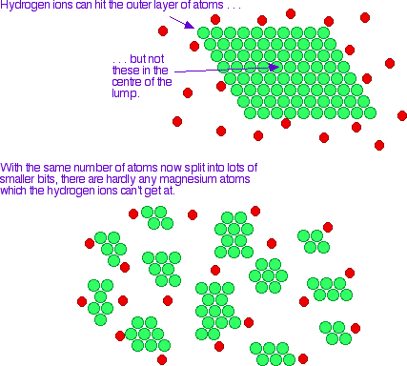
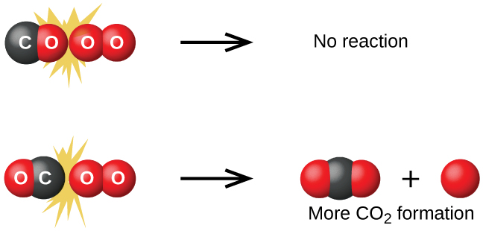
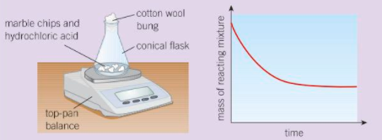
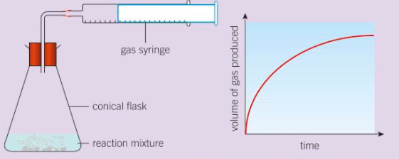
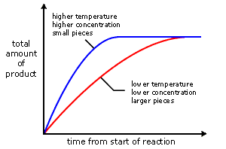
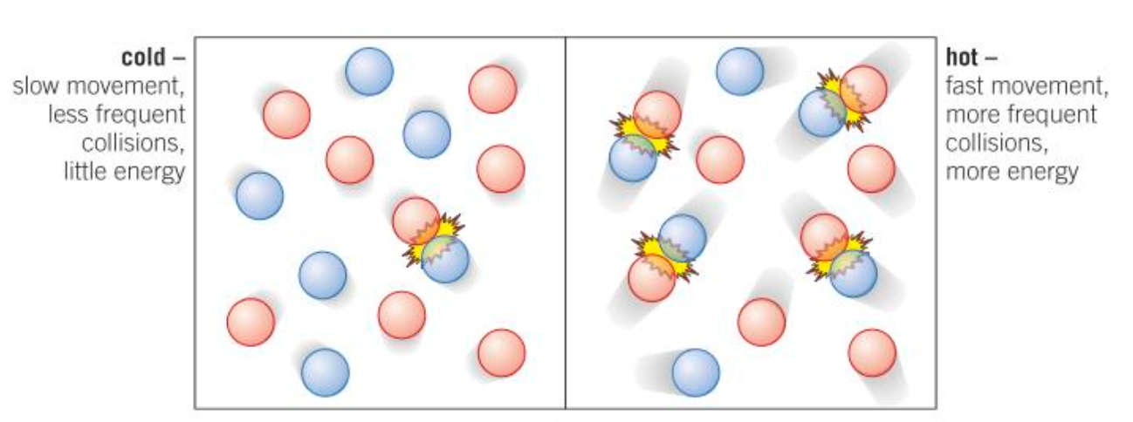
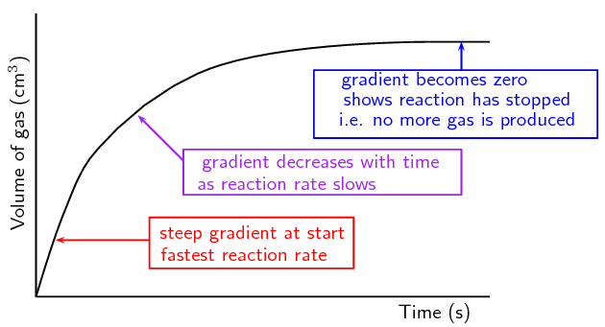
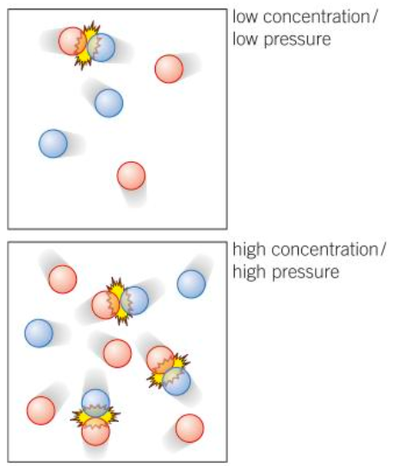
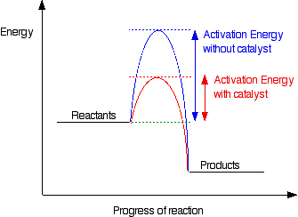
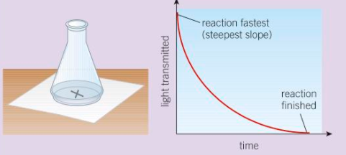
Measuring Rate
Collision theory
Rates of Reaction
Factors affecting rate
To measure the rate of a reaction you can:
Measure how fast the reactants are used up
Measure how fast the products are made
Surface area
For a reaction to happen reactants must:
collide with enough energy (activation energy)
More particles available to react.
More frequent collisions
e.g. Measure mass lost due to gas formed
A successful collision is one that leads to a reaction
Particles move faster.
So they collide more frequently.
Particles collide with more energy.
So more of the collisions are successful.
So to increase the rate of a reaction you must either
Increase the frequency of collisions
Increase the energy of the collisions
Decrease the energy needed for a collision to be successful
e.g. Measure volume of gas made
Temperature
Concentration and Pressure
Rate = volume of gas ÷ time
cm³/s
Catalysts
e.g. Measure time for insoluble product to form
More particles in the same space.
More frequent collisions
Lower the energy needed for successful collisions. (Activation energy)
Not used up.
Biological catalysts are called enzymes

