Slide 1
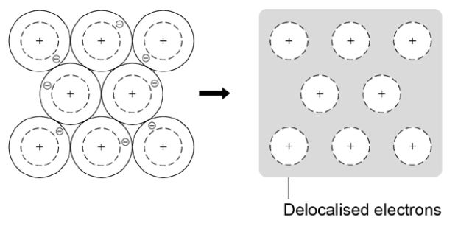
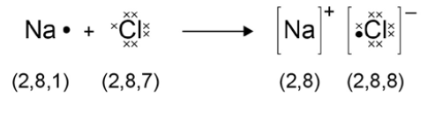
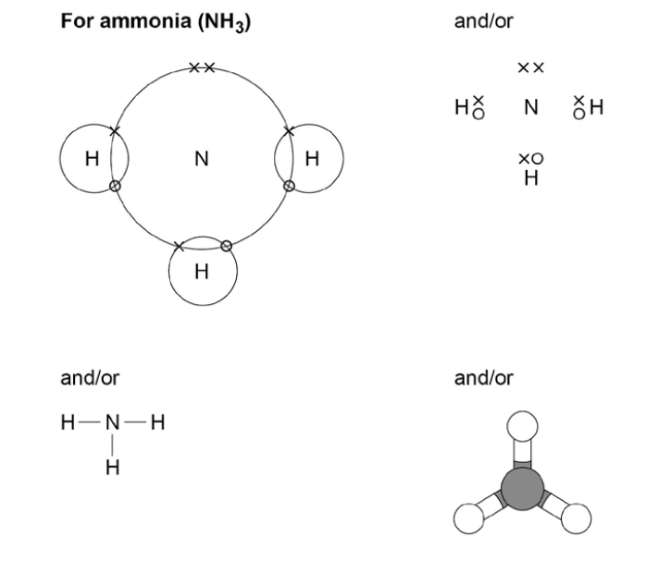
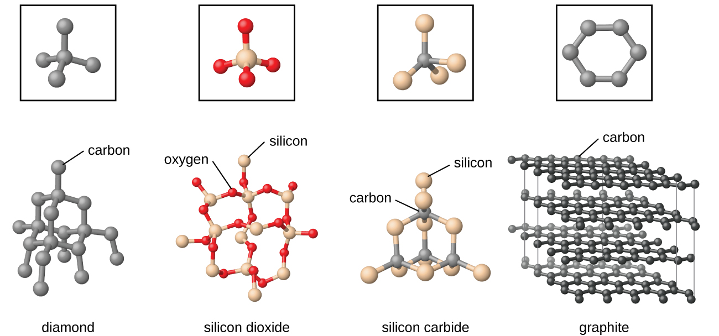
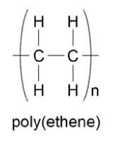
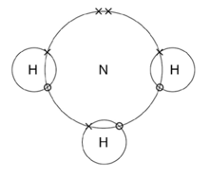
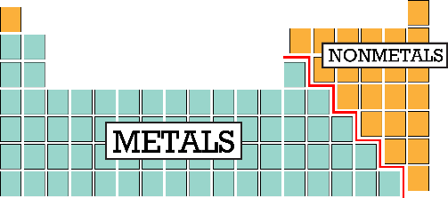

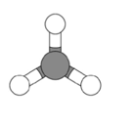
Metallic bonding
Structure and Bonding
Covalent Bonding
Ionic bonding
Metals LOSE ELECTRONS to form POSITIVE IONS
Two non-metals will SHARE pairs of electrons
STRONG bond formed.
Metals LOSE ELECTRONS to form POSITIVE IONS
Non-metals GAIN ELECTRONS to form NEGATIVE IONS
Electrons transferred from metal to non-metal
Small molecules
A small group of atoms sharing electrons
Giant Structures
Many atoms sharing electrons
GIANT structures of atoms in a REGULAR pattern
Delocalised electrons are free to move.
What is a metallic bond?
Sharing delocalised electrons – STRONG metallic bonds.
Ions have electronic structure of a noble gas
What is an ionic bond?
STRONG electrostatic force of attraction between oppositely charged ions
Which type of bonding is it?
polymers
Limitations of these models
How do we quickly work out the charges on ions?
M:M
Metallic
NM:NM
Covalent
Model | Limitations
Dot and cross | Looks like electrons aren’t identical Electrons look like they are in fixed positions
Displayed formula | Doesn’t show true shape of the molecule
Ball and stick | Can attempt to show 3D shape but doesn’t show electrons
M:NM
Ionic
Group | Electrons in outer shell | Charge on ion
1 | 1 | 1+
2 | 2 | 2+
6 | 6 | 2-
7 | 7 | 1-

Slide 2
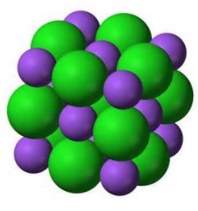
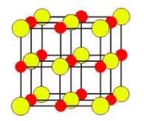
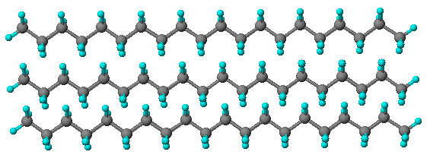
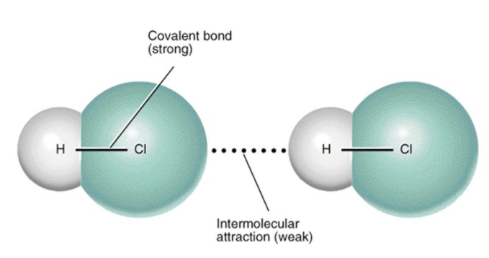
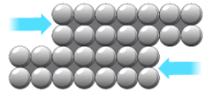
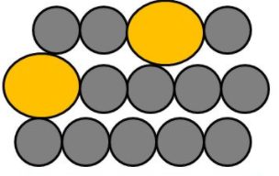
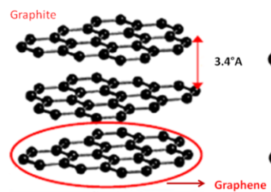
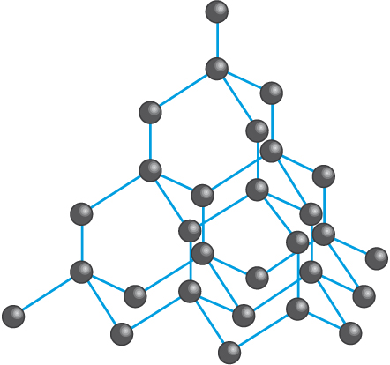
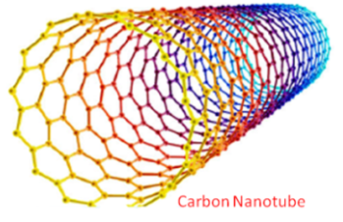
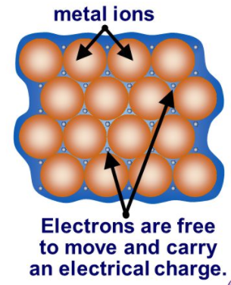
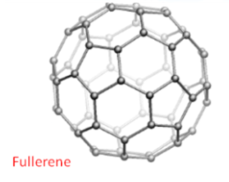
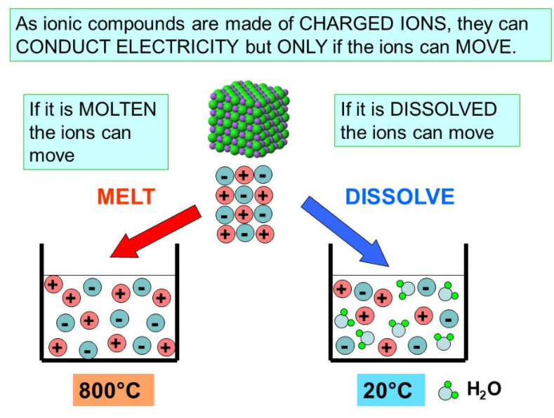
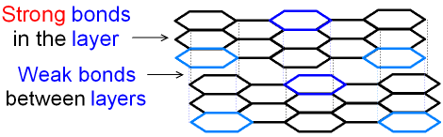
Properties of Metallic Substances
Properties of Ionic Substances
C3 Structure and Bonding
Properties of Covalent substances
Metals have high melting and boiling points
because…
Ionic compounds have high melting and boiling points
because…
Small molecules
…they are giant structures of atoms with strong metallic bonding
Giant Structures
Small molecules have relatively low melting and boiling points
because…
Can be bent or shaped
because…
Polymers are solids at room temperature
because…
Giant covalent compounds have high melting and boiling points
because…
…atoms are arranged in LAYERS which can SLIDE over each other
…intermolecular forces increase with the size of the molecules and polymer molecules are very large.
…they are giant structures of atoms (giant ionic lattice) with strong electrostatic forces of attraction in ALL DIRECTIONS between oppositely charged ions.
A large amount of energy is needed to break the many strong bonds.
…all of the atoms linked by strong covalent bonds.
Alloys are harder than pure metals
because…
…intermolecular forces are overcome on melting and boiling and these are weak forces.
Diamond is very hard, has a very high melting and boiling point and doesn’t conduct electricity
because…
Graphene is strong, light and an excellent conductor of thermal energy and electricity.
because…
Alloys are a mixture of two or more elements, at least one of which is a metal
The bigger the size of the molecule the higher the melting and boiling point
because…
…the layers are DISTORTED so can’t slide over each other
Only conduct electricity when melted or dissolved in water
because…
…each carbon is bonded to 4 other carbons by strong covalent bonds. There are no free electrons.
…it is a single layer of graphite so has free electrons.
…intermolecular forces increase with the size of the molecules.
Metals are good conductors of electricity and thermal energy
Because…
…the ions are free to move and so charge can flow.
Graphite is very hard, has a very high melting and boiling point and does conduct electricity
because…
Fullerenes (e.g. carbon nanotubes) are extremely strong and are excellent conductors of thermal energy and electricity
because…
Don’t conduct electricity
because…
…the molecules have no overall electric charge.
…each carbon is bonded to 3 other carbons by strong covalent bonds. It forms layers of hexagonal rings with no covalent bonds between layers. There are free electrons.
…the electrons are free to move and carry thermal energy and charge
… they have strong covalent bonds and free electrons.

