Slide 1
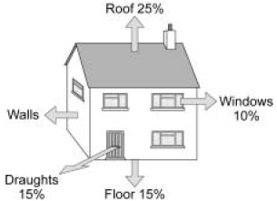
P1 REVISION – ENERGY TRANSFER BY HEATING
Draw a diagram to show conduction:
Fill in the diagram and label the arrows:
Solid Liquid Gas
Draw a diagram to show convection:
What is Radiation:
Calculate the percentage of
energy lost through the walls:
How is heat transferred by infrared radiation?
KEY WORDS:
Infrared radiation
Conduction
Convection
Radiation
Evaporation
Diffusion
Free electrons
Density
Specific heat capacity
Insulation
U-values

Slide 2
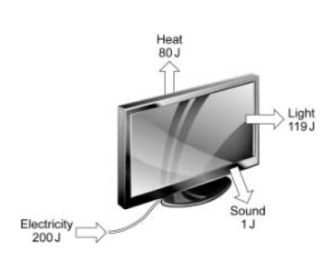
P1 REVISION – USING ENERGY
Write a definition for these different types of energy:
Magnetic:
Kinetic
Thermal:
Light:
Gravitational potential
Chemical:
Sound:
Electrical:
Elastic potential
Nuclear:
Here is a sentence to help you remember them:
Most Kids Hate Learning GCSE Energy Names
What is conservation of energy?
Calculate the amount of energy wasted as heat:
Calculate the efficiency of the television:
What is useful energy?
What is wasted energy?
KEY WORDS:
Chemical energy
Kinetic energy
Gravitational potential energy
Elastic potential energy
Electrical energy
Conservation of energy
Useful energy
Wasted energy
Newtons (N)
Joules (J)
Sankey diagram
Efficiency
ASSESSMENT:

Slide 3
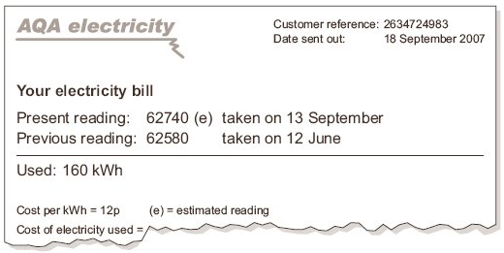
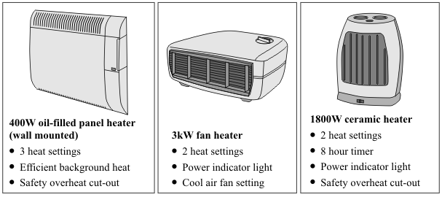
P1 REVISION – ELECTRICAL ENERGY
What is the cost of this electricity bill?
Fill in the gaps:
Appliances | Useful Energy | Wasted energy
Light bulb
Electric heather
Electric toaster
Electrical kettle
Hair dryer
Electric motor
DVD drive
If you needed to use a heater for 5 hours, which of these would be the most cost effective?
KEY WORDS:
Watt (W)
Kilowatt (kW)
Kilowatt-hour (kWh)
Electricity meter
Cost effective

Slide 4
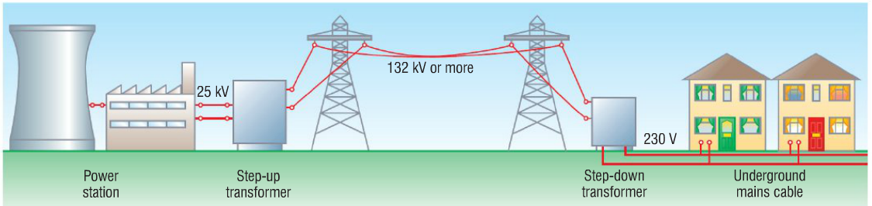
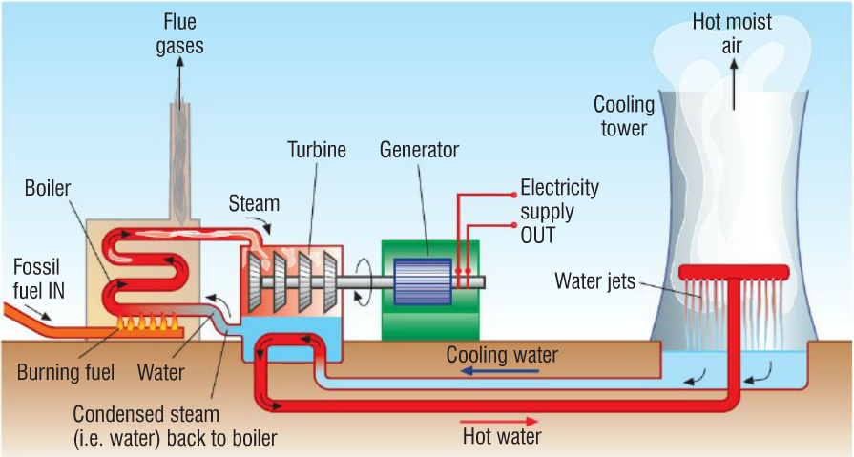
P1 REVISION– GENERATING ELECTRICITY
Why do we need to step- up and step-down the
voltage?
Explain supply and demand in terms of generating electricity:
Fill in this table:
Name of Energy Source | 2 Advantages | 2 Disadvantages
Fossil fuel
Renewable energy source
Label the parts of the power station:
KEY WORDS:
Biofuel
Atomic nucleus
Nuclear fission
Renewable energy
Wind power
Hydroelectric power
Tidal power
Solar cells
Solar heating panels
Geothermal energy
Acid rain
Carbon capture and storage
National grid
Step-up transformers
Step-down transformers

Slide 5
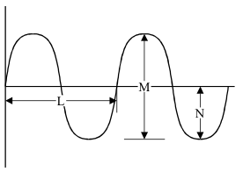
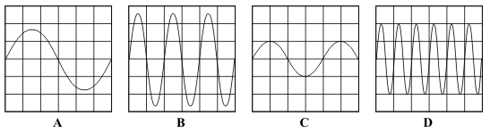

P1 REVISION – WAVES
Name the parts of the wave:
L =
M =
N =
O =
P=
What is meant by the frequency of a wave?
(Draw a diagram to explain)
What is meant by the wavelength of a wave?
(Draw a diagram to explain)
What are electromagnetic waves?
O
P
Describe the sounds:
A:
B:
C:
D:
What causes a sound wave?
Complete the equation:
Wave speed = frequency X _______
_________ = Hz X m
v = X
KEY WORDS:
Mechanical Electromagnetic Perpendicular
Transverse
Longitudinal
Amplitude
Wavelength
Frequency
Plane mirror
Normal
Angle of incidence
Angle of reflection
Refraction
Diffraction

Slide 6
P1 REVISION – ELECTROMAGNETIC WAVES
Fill in the gaps in the electromagnetic spectrum:
Radio
Microwave
Infrared
Visible light
Ultra violet
X-Ray
Gamma
What is the wavelength of light?
What is the Doppler effect?
How do communicate using waves:
Why are mobiles phones considered dangerous?
What do we use visible light for?
What do we use infrared for?
What do we use microwaves for?
What do we use radio waves for?
What is red shift?
KEY WORDS:
Radio
Microwave
Infrared
Visible light
Ultraviolet
X-ray
Gamma
White light
Optical fibres
Doppler effect
Big bang theory
Cosmic microwave background radiation

