Slide 1
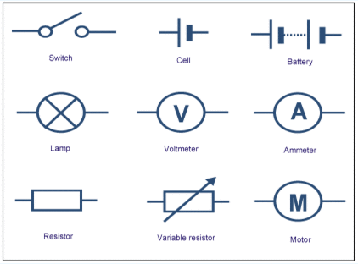
GCSE Physics 5: Electric Circuits
Static Electric
Static- Static is caused by friction between two surfaces. It means ‘still’ and builds up in one place.
Static electricity is produced when two insulators (objects which do not conduct electricity) are rubbed together. It can cause sparks to be produced.
Insulator- Does not let electricity flow through it. It is the opposite of a conductor.
E.g.
Trampoline
As you bounce up and down friction occurs between you and the air.
You become electrically charged.
Then, when you touch metal you get an electric shock because metal is a conductor of electricity.
If you touched a person, you and they would also experience an electric shock because the transfer of electricity can cause a spark.
The flow of electricity is called a current. Electrons make up this current. They are what travel round the wires in a circuit.
e-
Electrons
Protons
+
Neutrons
+
e-
An atom

Slide 2
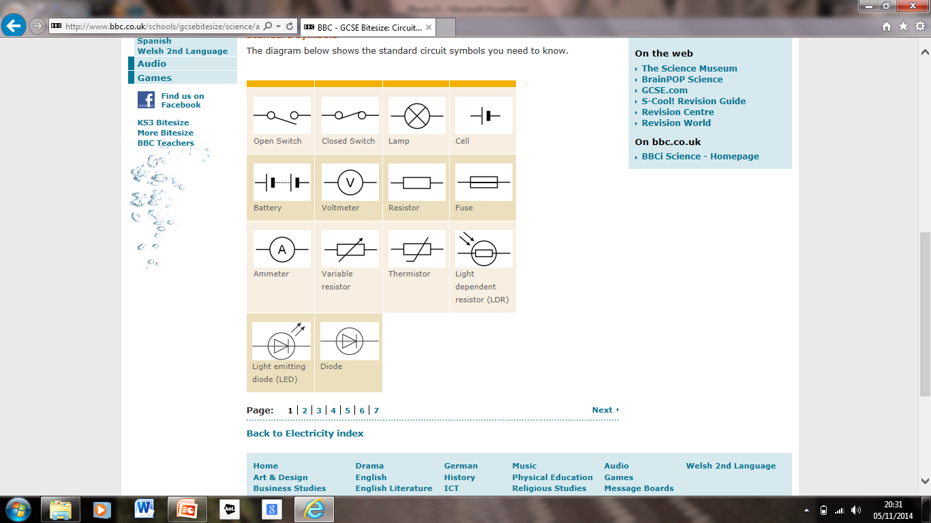
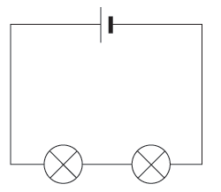
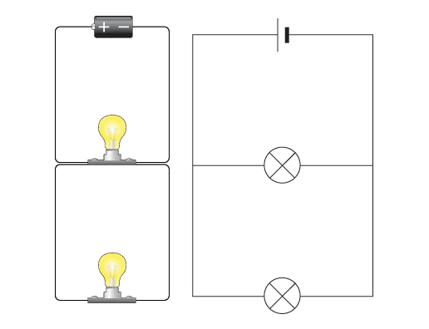
Static Electric Question
Static electricity occurs when two insulators (like nylon and rubber) are rubbed together. When this happens, the electrons moved around and sometimes transfer from one insulator to the other. When this happens, the insulator with more electrons has a bigger negative charge. When this insulator touches a conductor, the electrons transfer to it and so when, for example, somebody touches a metal rail (like a stair rail) sparks are produced as the electrons are earthed. It is unlikely that the electric shock could hurt this person but say, say for example, if someone had a pace maker or any other existing medical issues, the risk to harm being done to them would increase.
Circuits
Series circuit- a series circuit has just one loop.
A parallel circuit has several branches/loops that run parallel to one another.
Ammeter- An ammeter measures current (the flow of electricity). It measures the number of electrons that keep going round the circuit. The electricity flows through the ammeter. It counts the electrons as they go round the curcuit.
Voltmeter- Measures Voltage/how much energy.
Electrical Symbols
(Fixed)
Power Supply
M
G
Motor
Generator
Junction of Conductors
Battery or Cells

Slide 3
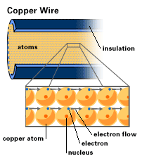
Resistance
Heat & Wires
Battery is added- the electrons of the atoms start to move because they gain energy.
The electrons collide into the nuclei of the ions (remember that they have lost electrons so they are no longer atoms) heat is produced due to the friction when the nuclei and electrons rub against each other.
The wire gets hot.
When an electrical current flows through a wire, the free and moving electrons (that gain energy from the power supply) collide with the nuclei of
the ions. This friction (produced when the nuclei and electrons rub against each other) produces heat and so the wire gets hot.
Heat & Light Bulbs
Light bulbs get hot because the filament (the wire inside a light bulb) is so thin and narrow that more collisions occur between the nuclei and free flowing electrons and so more heat is produced.
Power
Powerful- how much energy a device needs to work (watts).
Power= Current x Voltage
(w) (A ) x (V)
Amps- A already used in another equation
W
I
V

Slide 4
Energy= Power x Time
Variable Resistors
(J) = (W) x (S)
A
Energy companies use:
KWh = Kilowatts x Hours
Kilowatt hours = KW x H
… because it is more practical because they need to calculate huge amounts of energy.
Why A Wire Gets Hot
When an electric current flows through a wire, the free and moving electrons (that gain energy from the power supply) collide with the nuclei of the ions. This frictions- produced when the nuclei and electrons rub against each other) produces heat and so the wire heats up.
Why A Light Bulb Gets Hot
A light bulb gets hot because the wire is so thin (it’s called the filament) more collisions occur and so more heat is produced.
6A
6A
(1000J)
A
The current is the same all the way round in a series circuit.
LDR- Light Dependent Resistor- The resistance changes dependant on the amount of light available.
The more light (the higher the intensity) the less resistance there is.
E.g. A security light- would want it to come on when it was dark only + when someone moves.
E.g. Street lamp- Comes on when it’s dark.
Resistance
Light intensity

Slide 5
Thermister
Responds to heat- e.g. oven (so it stops at the right temperature) and a kettle (switches off when it reaches a certain temperature).
Resistors- All resistors control the current by either speeding it up or slowing it down.
Electro- Magnetic Induction (Generating Electricity)
In order to make electricity, you need a coil of wire, a magnet and movement.
(D.C.) Direct Current (battery)- Electrons/ current flows in one direction only.
(A.C.) Alternating Current- Caused by moving a wire in a magnetic field.
Method One
If you move a wire through a magnetic field, the sensitive ammeter shows the reading while the wire is moving. This is called ‘Induced current’.
When we move the wire back up again, the induced current will run in the opposite direction.
Method Two
Another way to generate an induced current is to move a magnet into a coil of wire. There is a reading on the ammeter while the magnet is moving into the coil.
The electricity is generated when the coil of wire cuts through the magnetic field. Cutting= when the electricity is made.
Resistance
More heat = Less resistance
Temperature

Slide 6
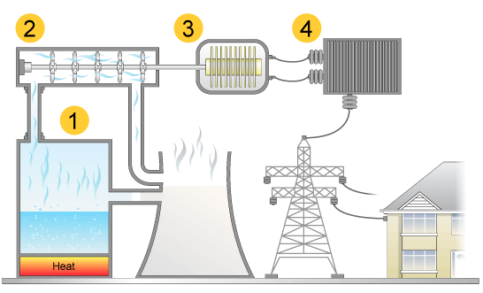
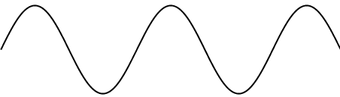
Power Stations
Chemical energy (resources like coil, oil and natural gas) are burned to produce heat (energy).
The heat energy (made by burning fossil fuels) makes the water turn into steam- steam rises.
The steam travels through the pipes to the turbine and so turns the turbine- the steam has lots of kinetic energy.
Again, as kinetic energy, the turbine turns the coil of wire and cuts through the magnetic field- there is a magnet in the coil. This generates the electricity because the electrons start to move to form a current.
Transformers step up (increase) the voltage or step down (decreases the voltage. Generally, they step it down to 230V which is the voltage of the mains supply in our homes.
The National Grid (lots and lots and lots of wires) get the electricity to our homes.
Electro-Magnetic Induction
Electro (electricity)
Magnetic (Magnetic field)
Induction (started)
Direct- from a battery
Alternating- In a generator (magnet n a coil of wire etc.)
This graph shows us when the electricity is being produced. When we dip a magnet into/ out of a magnetic field.
No electricity is generated when the magnet does not move (for the tiny amount of time it isn’t moving between going up or down). Movement is required for the electricity to be made.
Moving down
Magnet not
moving
Voltage or
Current
Moving up

Slide 7
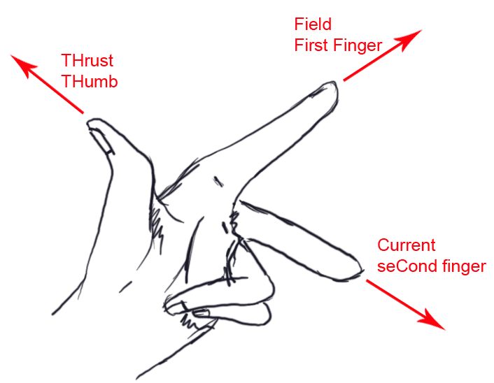
Alternating Current
Is more efficient travelling over long distances because less energy is lost.
The voltage can be changed
Alternating current can be changed into direct current.
Direct Current
Loses more energy when travelling over long distances.
The voltage of direct current can not be changed.
Often, we need to change alternating current to direct current because many house hold appliances work off direct current.
Motors
When there is a coil of wire in a magnetic field, a current is produced.
When a coil of wire has a current running through it, a magnet is produced.
When a current flows through a coil of wire in a magnetic field, a magnet is produced.
Magnet + Electricity = Movement
Left Hand Rule
First Finger- Direction of the magnetic field (North to South).
Second Finger- Direction of current (Positive or Negative). Direction of arrows on the wire.
Thumb- Movement of the wire.

Slide 8
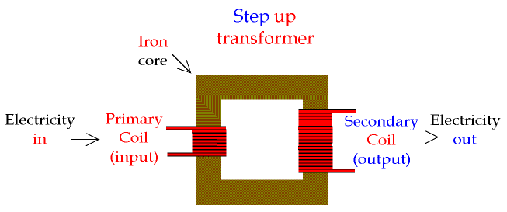
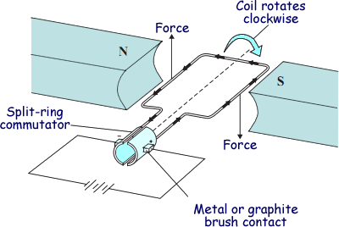
Motors
A motor is a circuit component that moves when it receives a burst of electricity when in between two magnets. We can first figure out what way a motor will spin by using the ‘left hand rule’ because the magnet provides a magnetic field (the north to south) and the motor has a current (the arrows). As the motor spins, the current changes direction (if there was permanent contact between the brushed and the split ring). The motor will spin in one, constant direction if the brushes and split ring touch after each half turn because the current changes direction. By this contact, the current, after each half turn, receives a ‘push’ in the same direction.
Rather than having a fixed wire, the electric circuit now includes a pair of brushes that rub against the split ring/ commutator. Each part of the split ring touches one brush every half turn and the next brush on the next half turn. This means that the current reverses direction every half turn and so keeping the coil rotating.
Transformer
Label the voltage going in.
Label how many coils of wire there are on each side.
Substitute the numbers into the equation.
Vp = Np
Vs Ns
Transformer Equation
Voltage
No. Of Coils

Slide 9
Transformers Change The Voltage
Mains Electricity Supply (230V) =
Power = Voltage x Current
W = V x C
Electromagnetic:
Power Supply
Switch
Closed Switch- magnetic field created (Electricity flows through the coil of wire).
Current:
A coil of wire cutting through magnetic field
When the current starts to flow through coil one, the magnetic field spreads and so coil two also has a current,
Coil 1-
Electromagnet
Coil 2
Iron Core

