Slide 1
NMR Spectroscopy

Slide 2
What is it?
NMR uses radio waves to obtain information about H atoms in a molecule
NMR distinguishes between environments inside a molecule
This gives information about the carbon skeleton
You get far more information than you do from Mass Spec and IR
NMR Spectroscopy recognises protons.
It is often called Proton NMR or 1H-NMR
The protons all interact with radio waves
The frequency of interaction is determined by the ENVIRONMENT that they are in.

Slide 3
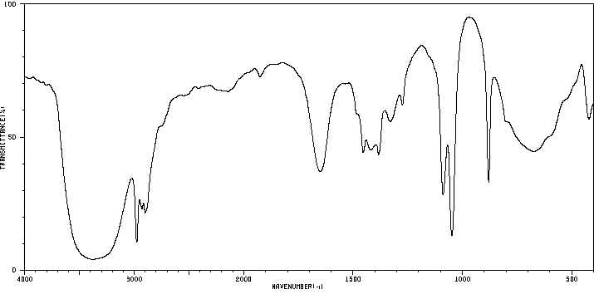
Ethanol
-OH stretch
C-O stretch

Slide 4
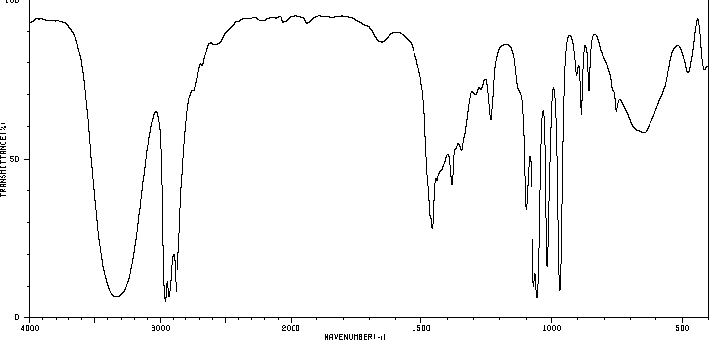
Propanol
-OH stretch
C-O stretch

Slide 5
Chemical Shift
Chemical shift is measured from TMS
Tetra-MethylSilane, (CH₃)₄Si
Protons in the same environments are shifted by the same amount
A hydrogen environment is the chemical surroundings around any one H atom or group of atoms;
Example:
For a CH3 group, the H atoms within the group have the same environment

Slide 6
3
2
4
1
H environment | No. H atoms | group
1 | 3 | CH3
2 | 2 | CH2
3 | 2 | CH2
4 | 1 | OH

Slide 7
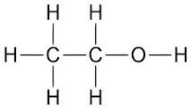
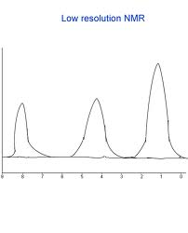
Answering Questions
To answer exam questions you must include information about the following aspects of NMR to gain max marks
Identify the number of chemical environments
Look up the values for the groups present using your data sheet
THEN look at splitting using n+1 rule
Consider Ethanol. A low resolution NMR you would expect to see 3 peaks as there are 3 hydrogen environments

Slide 8
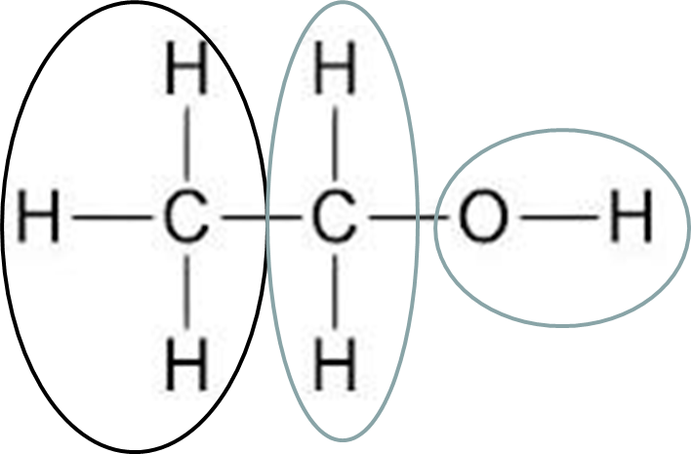
The n + 1 Rule (Splitting)
Many of the low resolution peaks are split into clusters of peaks
1 peak – single
2 peaks – doublet
3 peaks – triplet
4 peaks – quartet
This splitting of peaks gives important additional information
n + 1 rule
The amount of splitting tells you how many hydrogen atoms are on the adjacent carbon atom or atoms
The number of sub peaks is 1 more than the number of hydrogens attached to the next door carbon(s)

Slide 9
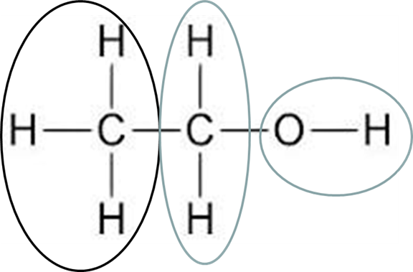
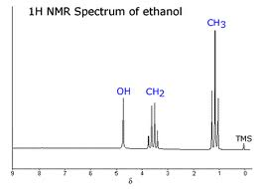
So For Ethanol
Adjacent to Carbon containing 3 H environments
(n+1)
Triplet
3
Adjacent to carbon attached to 3 atoms
n+1 rule
Will be split into a quartet
1
2
O-H Singlet. No Adjacent Carbon

Slide 10
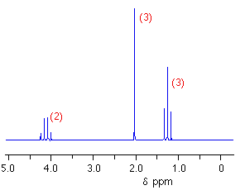
Example:C₄H₈O₂

Slide 11
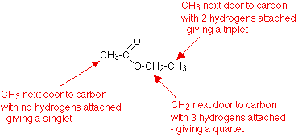
Example:C₄H₈O₂
CH3
no H present
CH3
Next to CH2
CH2
Next to CH3

Slide 12
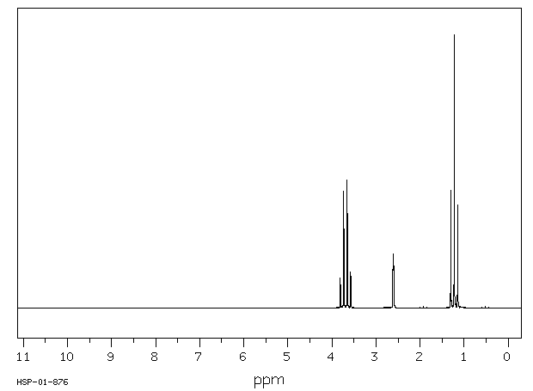
Ethanol Practice
³∫
²∫
¹∫

Slide 13
Ethanol Practice
Chemical shift 1.2
So R-CH
Integral 3
So R-CH₃
Chemical shift 2.7
Possible -OH
Integral 1
So -OH
Chemical shift 3.7
So O-CH-
Integral 2
So O-CH₂
³∫
²∫
¹∫

Slide 14

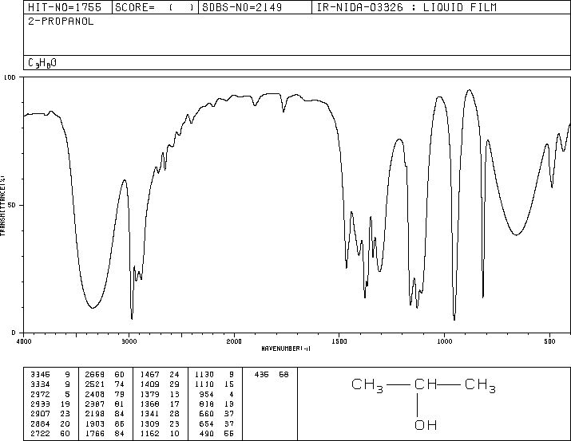
Propanols

Slide 15
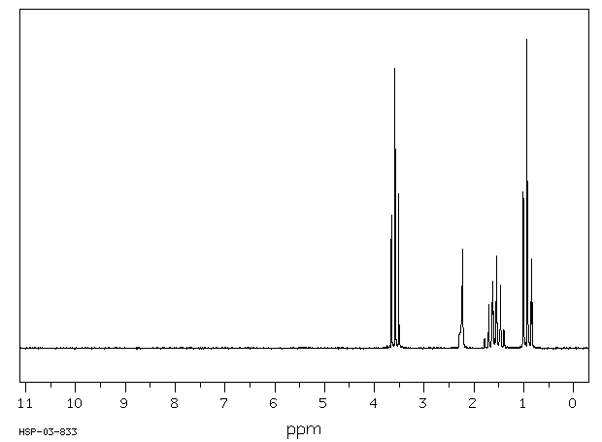
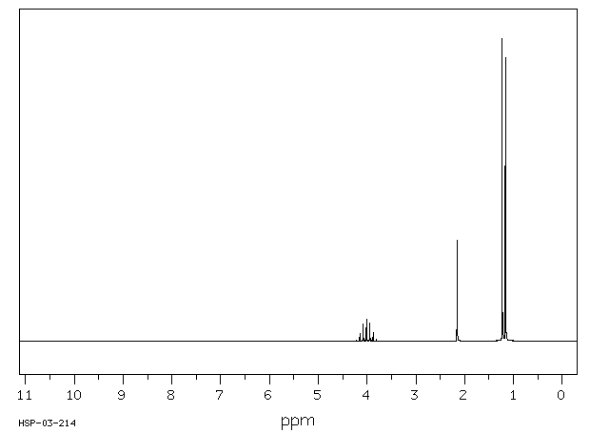
Propanols
Chemical shift 1.0
So R-CH
Four environments,
Four types of H
CH₃CH₂CH₂OH
Chemical shift 1.7
So R-CH
Chemical shift 2.7
Possible -OH
Chemical shift 3.7
So O-CH-

Slide 16
Propanols
Three environments,
Three types of H
CH₃CHOHCH₃
Two CH₃s are identical
Chemical shift 1.1
So R-CH
Chemical shift 2.7
Possible -OH
Chemical shift 4.0
So O-CH-

Slide 17
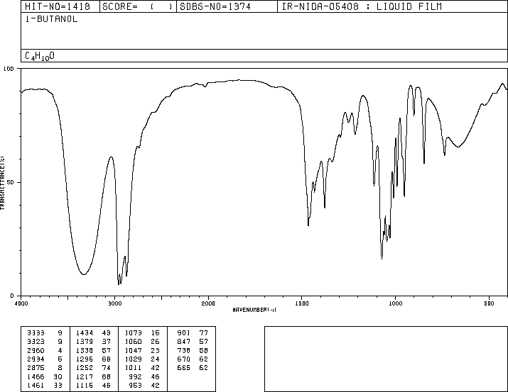
Butanols

Slide 18
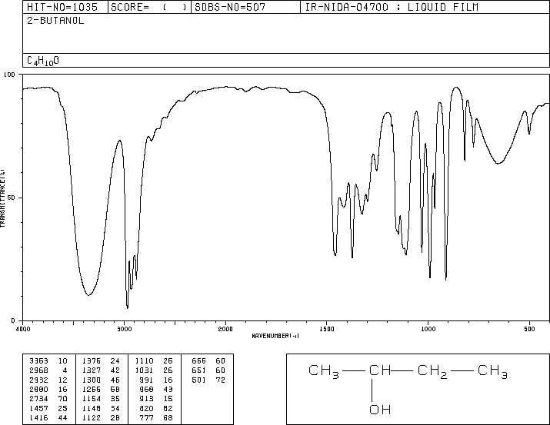
Butanols

Slide 19
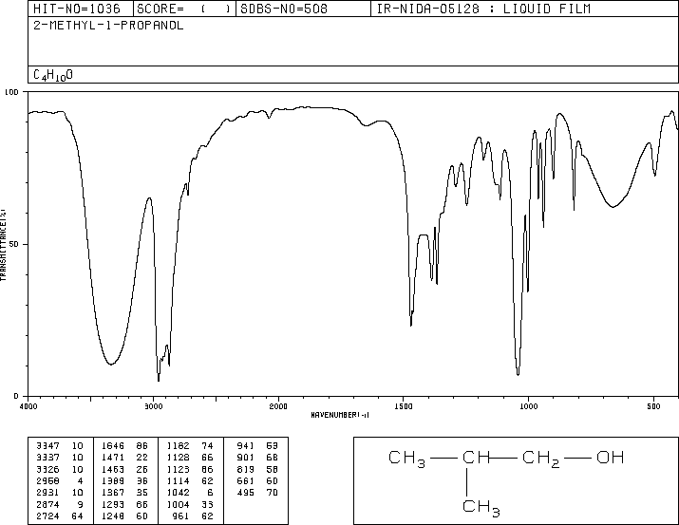
Butanols

Slide 20
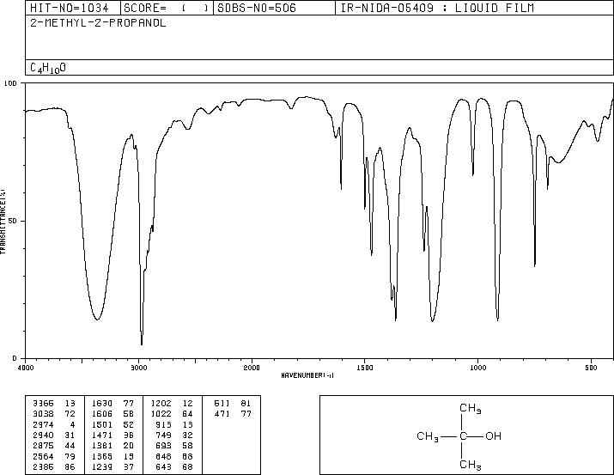
Butanols
Notes:
Not a lot of difference between the four spectra

Slide 21
Now match the NMR to the IR
Sorry, no integrals to help you

Slide 22
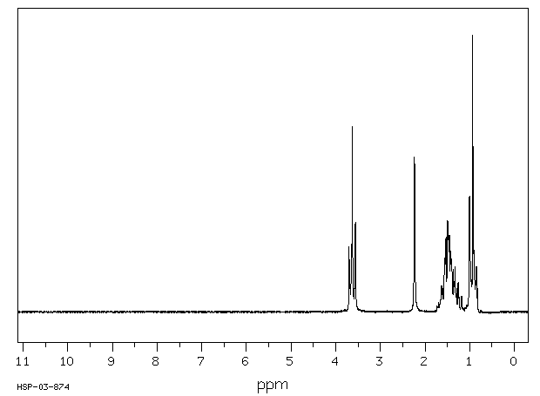
Butanols
Notes:
Butan-1-ol, two CH2 groups show up as identical

Slide 23
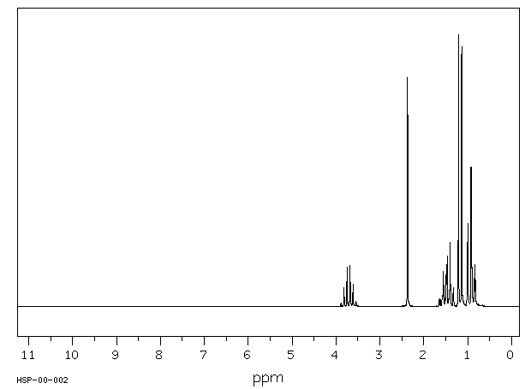
Butanols
Notes:
Butan-2-ol, 5 environments

Slide 24
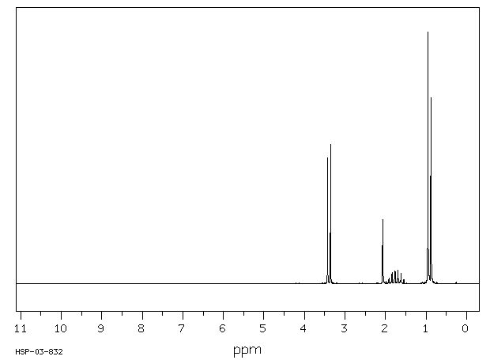
Butanols
Notes:
2 methyl propan-1-ol, 4 environments, 2 CH3’s identical

Slide 25
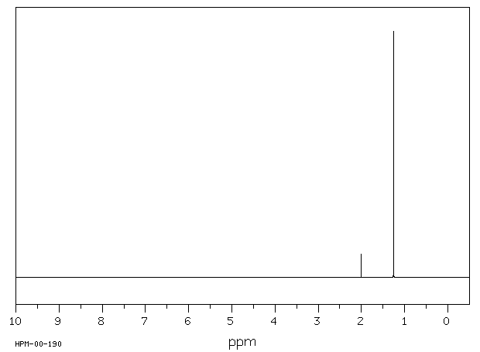
Butanols
Notes:
2 Methyl propan-2-ol, only two environments

