Slide 1
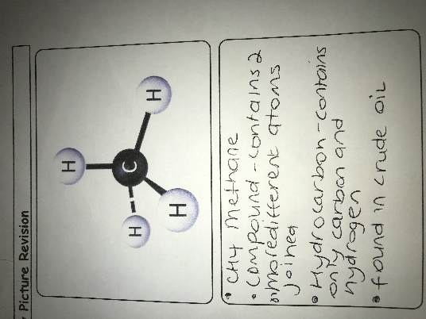
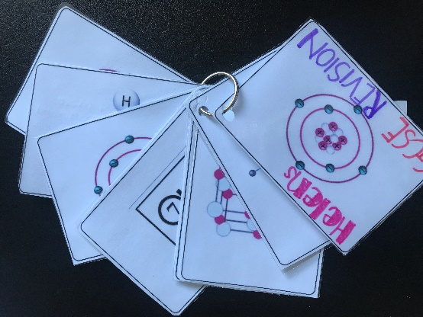
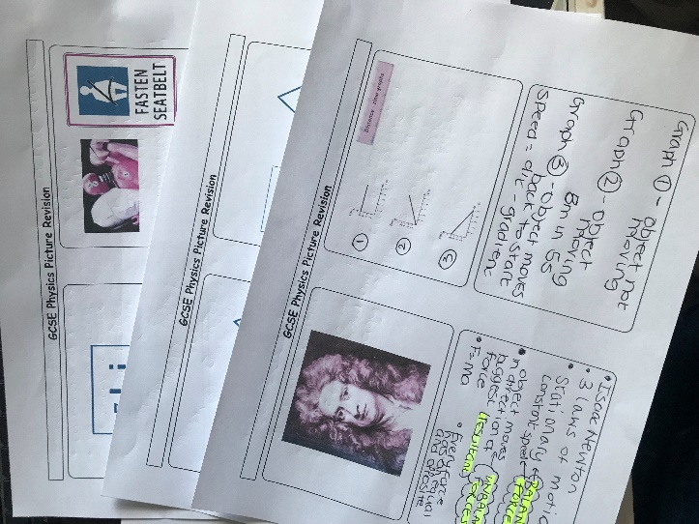
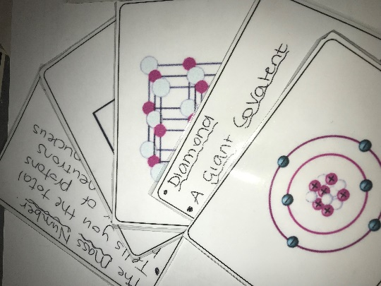
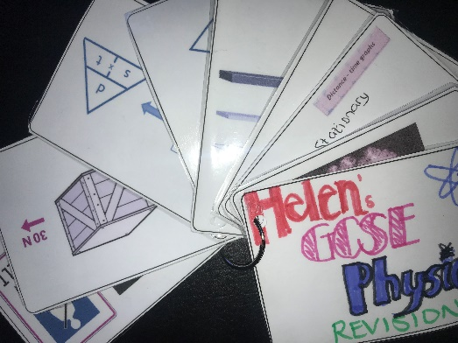
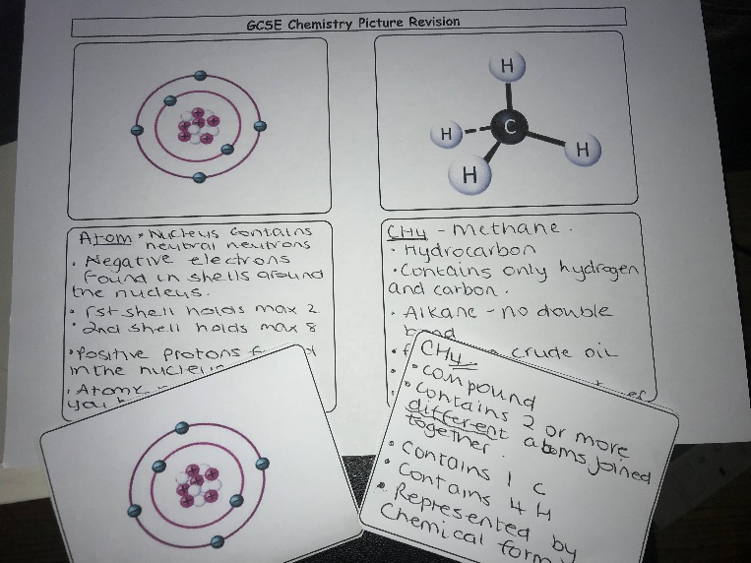
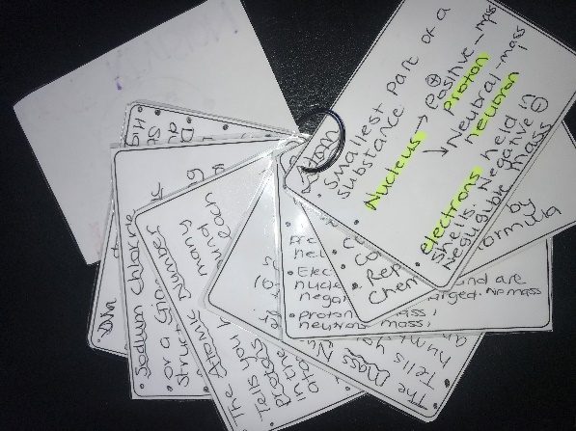
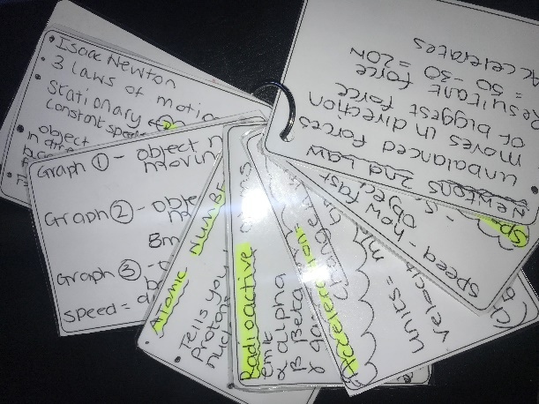
GCSE Physics 1: Picture Revision

Slide 2
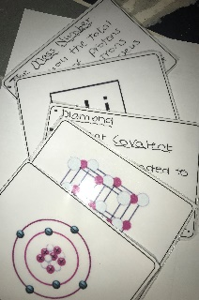
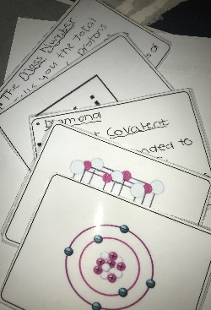

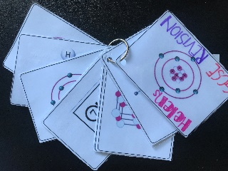
Ideas for Use
These can be used in a variety of ways. Here are some of the ways I have used them:
Starter-In the run up to the exam period, I use these as a starter activity. 1 picture per lesson. Pupils have to come up with 5 facts about the picture in 5 minutes (for example).
As a competition-display a picture then play Teacher v Class where pupils collectively have to try and recall more facts than me in a given time.
I have printed them out and given them to students in the form of a revision booklet, where they write the facts about each picture in the space below. Great way of getting pupils to highlight key facts.
I have printed these out and pupils have written the key facts about each underneath. I have then laminated them and made them into a set of revision cards for pupils.
Used them as revision tasks on social media to engage pupils in ‘daily revision’ workout challenge.
Feel free to use them as you wish. They are in PowerPoint for so they can be added to amended to suit your own needs.

Slide 3
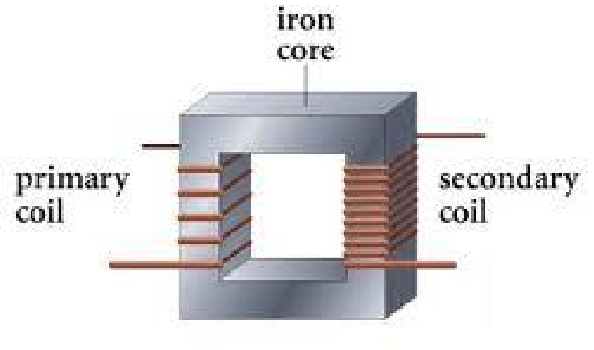
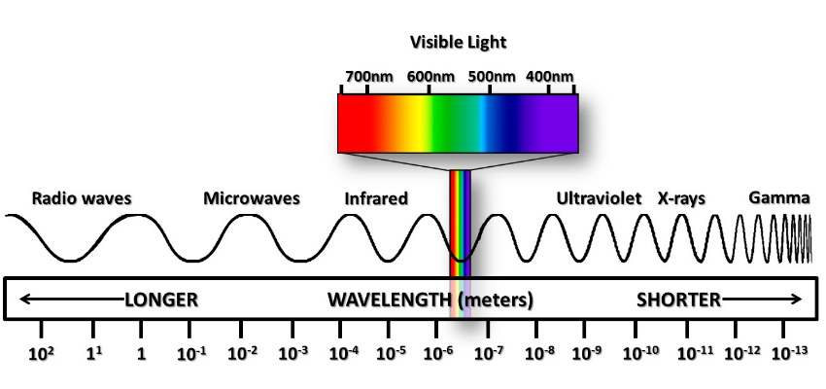
GCSE Physics Picture Revision
Notes:
3

Slide 4
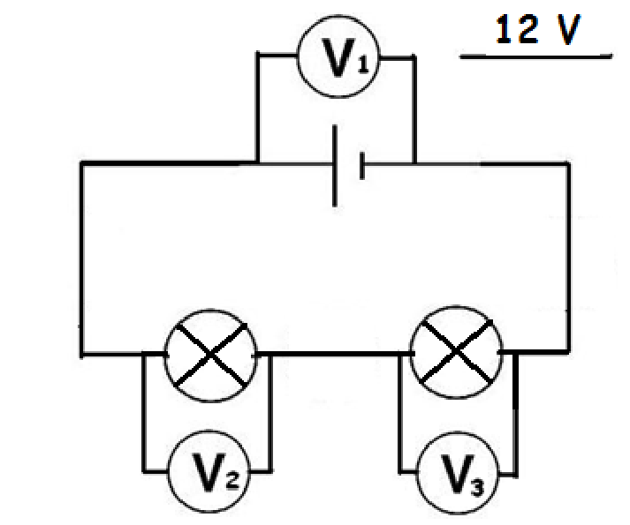
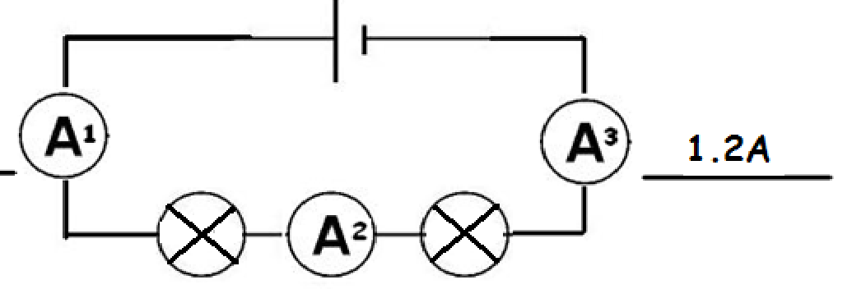
GCSE Physics Picture Revision
Notes:
4

Slide 5
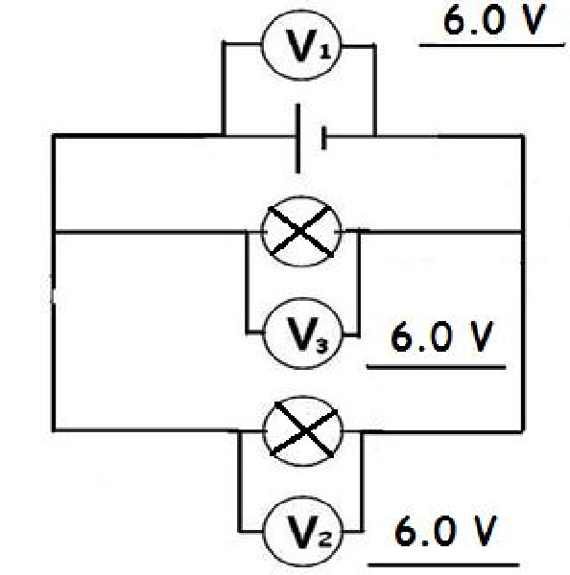
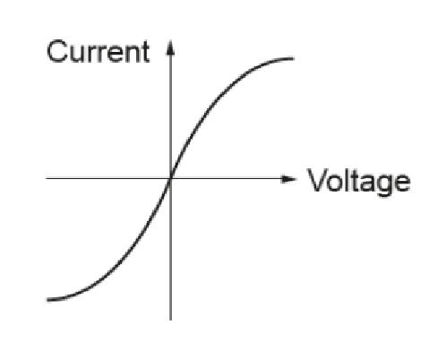
GCSE Physics Picture Revision
Notes:
5

Slide 6
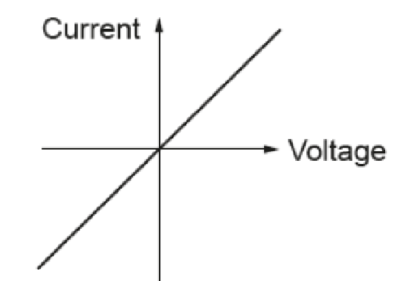
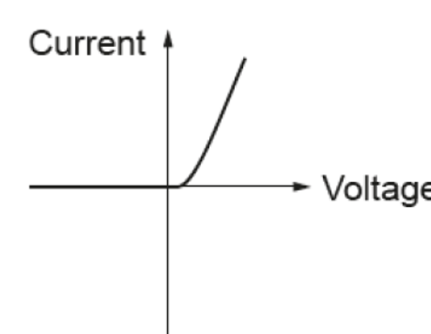

GCSE Physics Picture Revision
Notes:
6

Slide 7

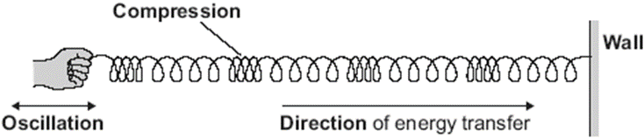
GCSE Physics Picture Revision
Notes:
7

Slide 8
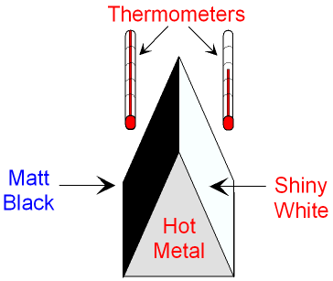
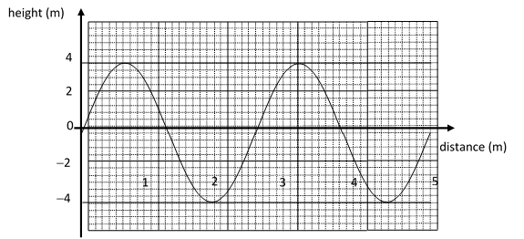
GCSE Physics Picture Revision
Notes:
8

Slide 9
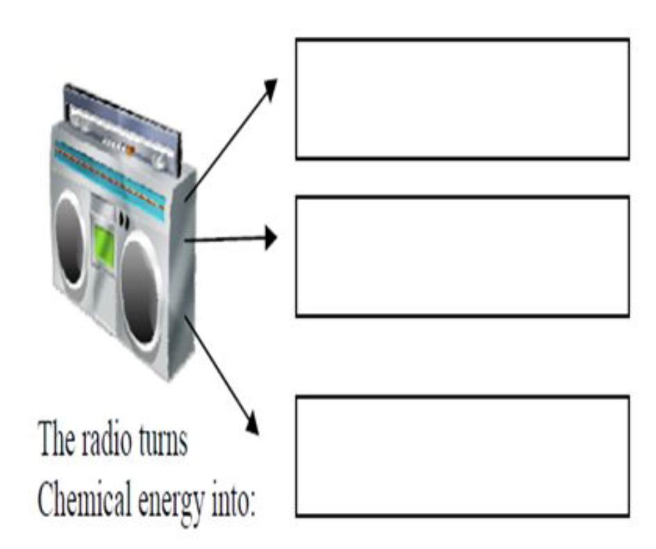
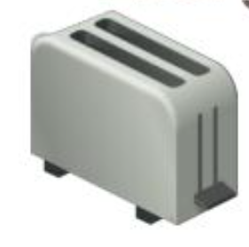
GCSE Physics Picture Revision
Notes:
9

Slide 10
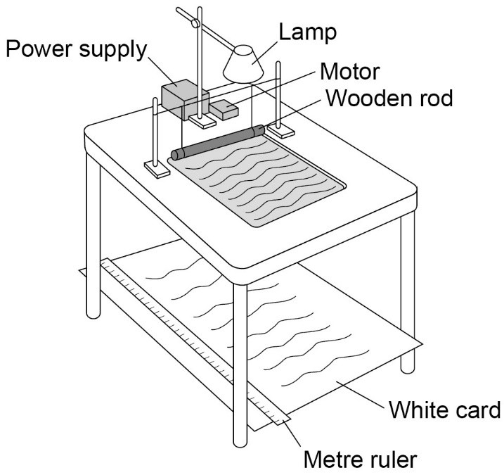
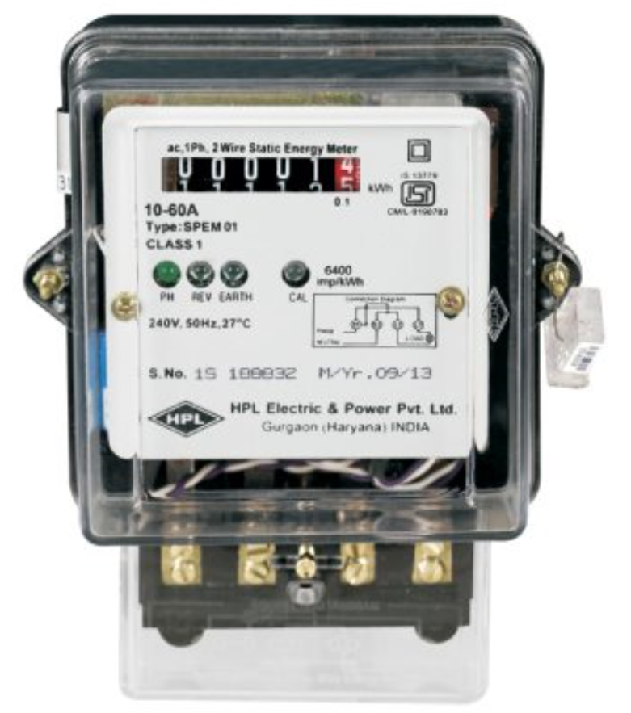
GCSE Physics Picture Revision
Notes:
10

Slide 11
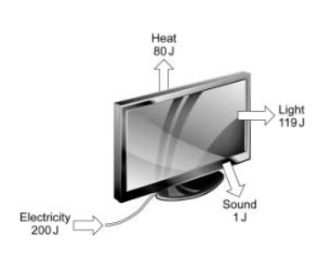
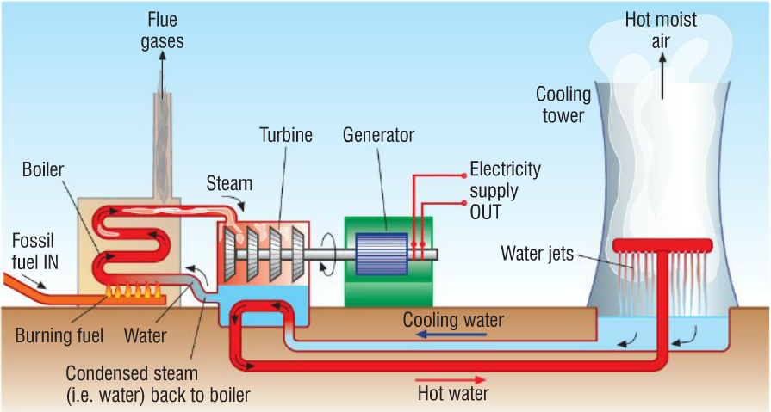
GCSE Physics Picture Revision
Notes:
11

Slide 12
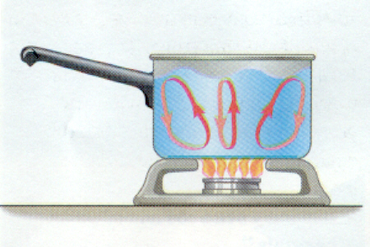
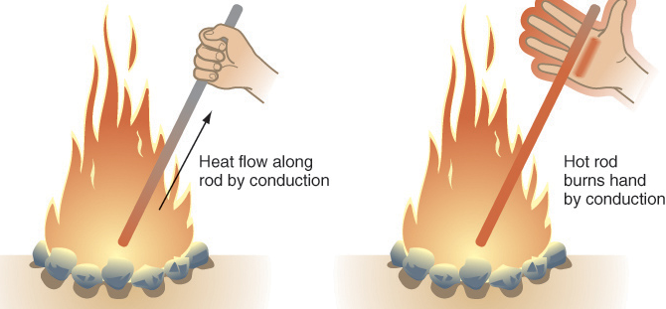
GCSE Physics Picture Revision
Notes:
12

Slide 13
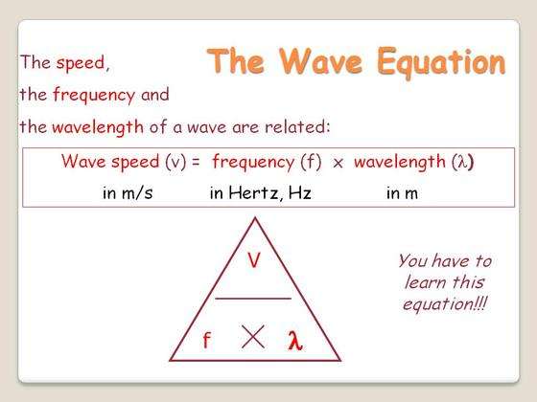
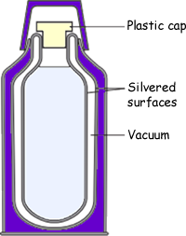
GCSE Physics Picture Revision
Notes:
13

Slide 14
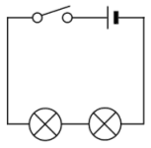
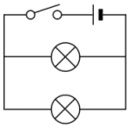
GCSE Physics Picture Revision
Notes:
14

Slide 15
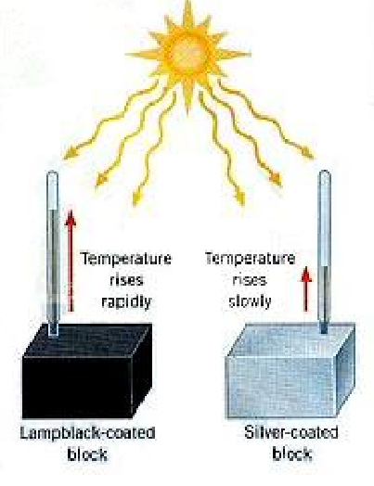
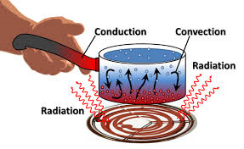
GCSE Physics Picture Revision
Notes:
15

Slide 16

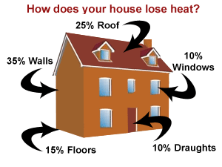
GCSE Physics Picture Revision
Notes:
16

Slide 17
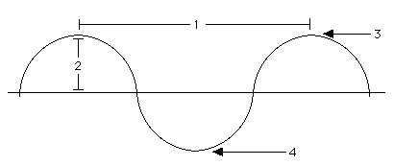
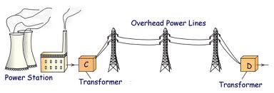
GCSE Physics Picture Revision
Notes:
17

Slide 18
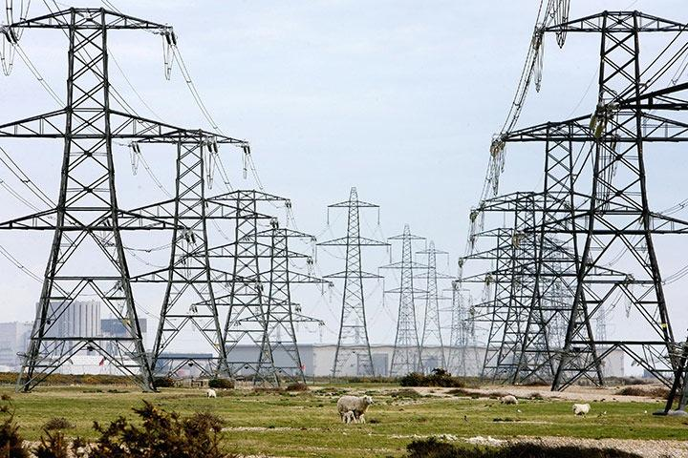
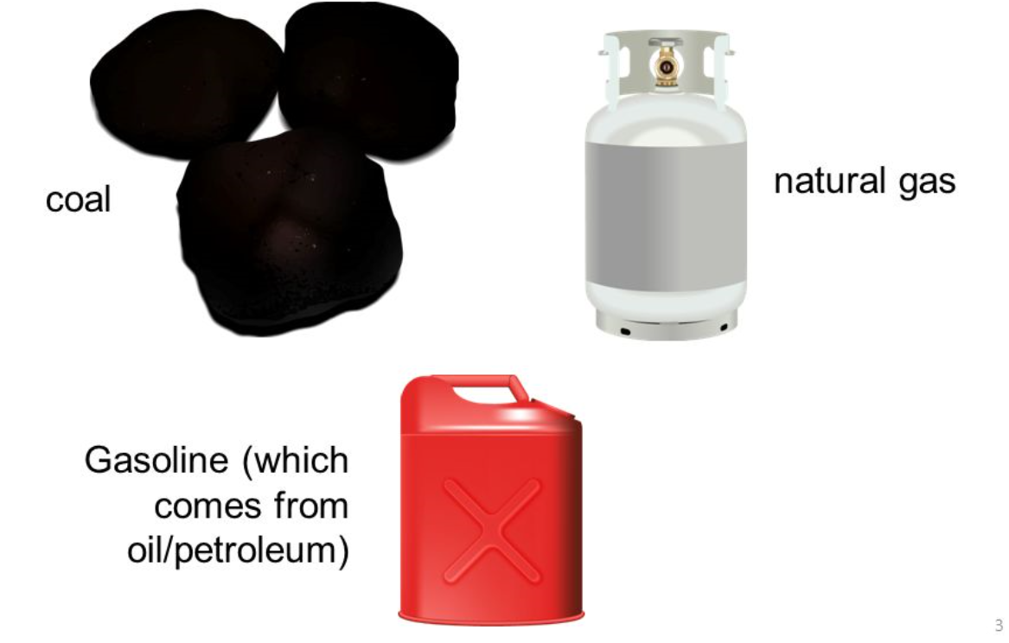
GCSE Physics Picture Revision
Notes:
18

Slide 19
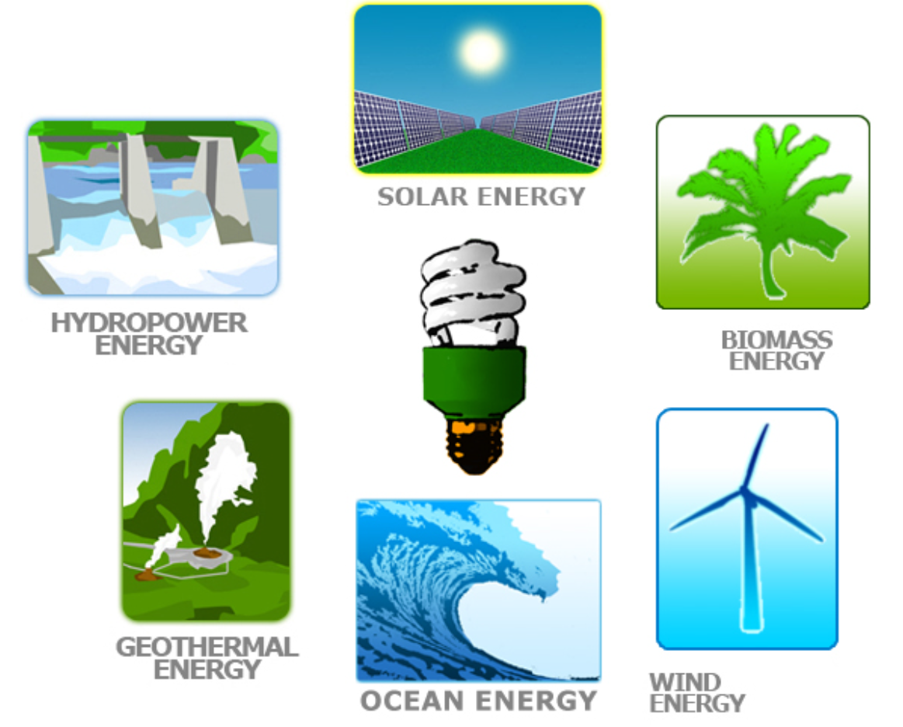
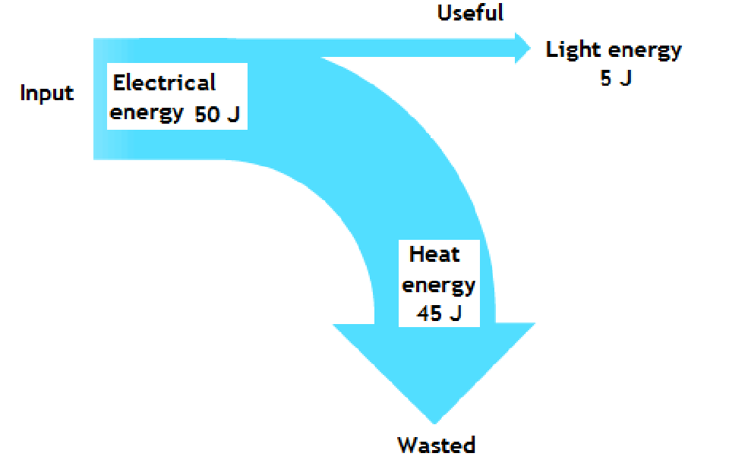
GCSE Physics Picture Revision
Notes:
19

Slide 20
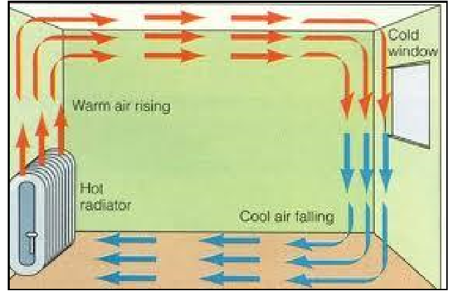
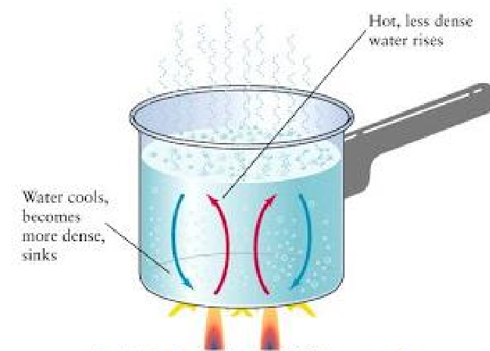
GCSE Physics Picture Revision
Notes:
20

Slide 21
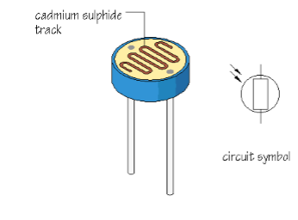
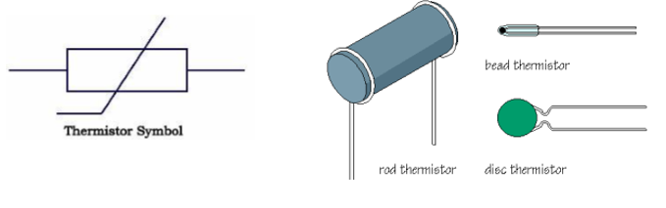
GCSE Physics Picture Revision
Notes:
21

Slide 22


GCSE Physics Picture Revision
Notes:
22

Slide 23
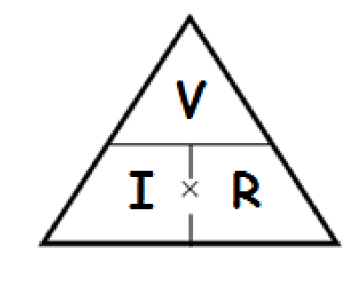
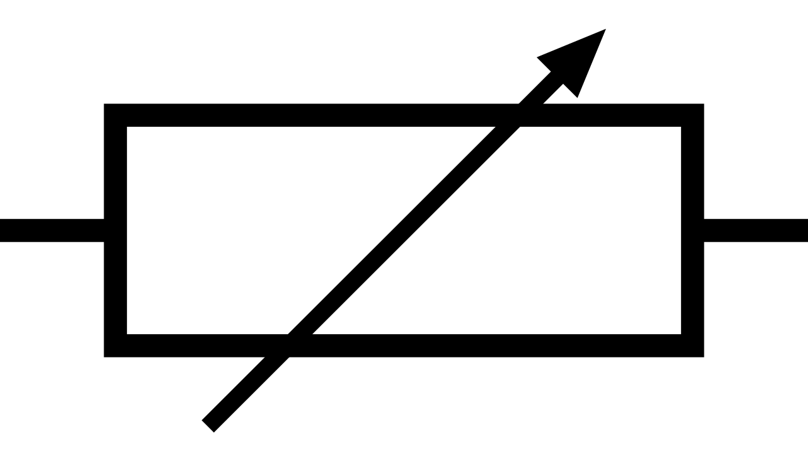
GCSE Physics Picture Revision
Notes:
23

