Slide 1
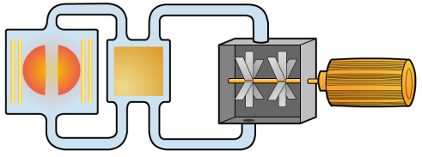
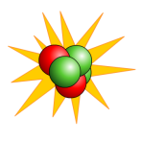




---
---
---
Releases heat
Heat turns
_____
Into steam
The steam turns the __________________
+
Nuclear power station
The generator turns _______________ energy into
__________________
Energy.
U
---
Nuclear power
+
fusion
---
Uranium U235
fission
+
+
Radio active waste
---
fusion
---
---
---
Fusion is better than fission because
_____________________________________________________________________________________________________________________
Is dangerous because
_____________________________________________________________________________________________________________________
Thus causes the problems of
_____________________________________________________________________________________________________________________
Solutions for storing the radioactive waste are
_____________________________________________________________________________________________________________________

Slide 2
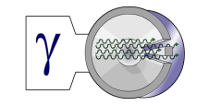
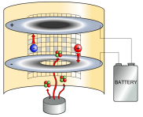
ALPHA
RADIATION
GAMMA
Has the symbol of __________
Has the symbol of __________
BETA
Alpha has the __________ penetrating power
gamma has the __________ penetrating power
Has the symbol of __________
Gamma causes the __________ ionisation.
Alpha causes the __________ ionisation.
beta is stopped by __________
Gamma is stopped by __________
Alpha is stopped by __________
Gamma is a type of __________ radiation
Beta is a high energy __________
Alpha is the nucleus of a __________ atom
Gamma is the __________ dangerous outside the body and the _________ dangerous inside the body
Alpha is the __________ dangerous outside the body and the _________ dangerous inside the body
Beta is used in controlling the thickness of _________________
Gamma is used to find cracks in ________ _____________
Alpha is used in a ________ ________.
Gamma is used in medical ________ and also to _______________ medical instruments.
Gamma is used to destroy ________ cells.
α

Slide 3
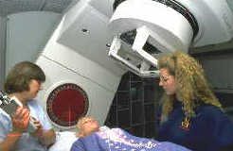
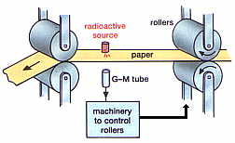

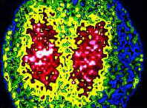
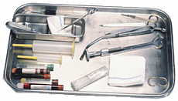
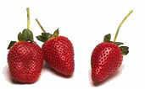
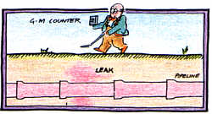
ALPHA
RADIATION
BETA
Alpha is used in a ________ ________.
This works when the smoke is ____________ an alarm is sounded
Beta is used in controlling the thickness of _________________
GAMMA
Gamma radiation is used to destroy ________ cells.
Gamma is used in medical ________ . A radioactive isotope is injected into the body
where it is absorbed and travels lets say to the kidneys. It emits ___________ radiation which is detected by a ___________ ray camera which makes a picture of the kidneys.
A gamma source is chosen because ____________________________________________________________________________
α
Gamma radiation is used to ________ medical instruments and food
The alpha particles ________ the air allowing the electric current to flow through the gap. Smoke particles block the _____________ particles stopping the ionisation of the air creating a __________ in the circuit causing the alarm to be sounded
Beta is used because it can pass through the paper but ______ particles are absorbed.
When the paper is too thin ______ particles pass through than normal so a signal is sent to the rollers to tell them to press down less.
If the paper is too thick _________
Beta particles _________________
So a signal is sent to cause the rollers to __________ more.
Gamma is used to find cracks in _________
Beta radiation is used to find cracks in ________________.
Beta is chosen because
__________________________________________________________
Half life is __________________. The sources used have half lives that are around a few hours long because_________________________________________________

Slide 4
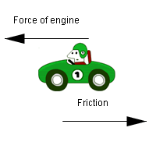
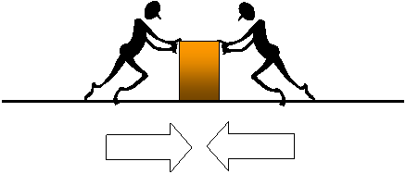
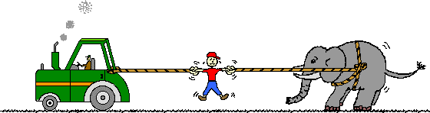
FRICTION
BALANCED FORCES
UNBALANCED FORCES
Occurs when the forces are _______ in size but __________ directions.
This gives a resultant force of __ N.
Any force that opposes motion is called ______ .
When caused by colliding with air particles it is called
____ _________________ or ________
Occurs when the forces are _______ sizes.
This gives a resultant force of anything but____ N
Unbalanced forces cause at least one of these to change
1 ____________________
2____________________
3____________________.
FORCES
VECTORS and SCALERS
Your ____________ is caused by gravity. It is measured in __________.
The measure of how much material is in your body is called ________. It is measured in _____.
NEWTONS 2ND LAW
Force = _______ x __________
______________ have magnitude such as ____________ , _______________ and ______________________.
_____________________ have magnitude and direction such as
_______________ ,__________________
and _______________
NEWTONS 1ST LAW
A body continues in it’s motion unless an ___________ _________ acts on it.
When a vehicle's velocity increases it is said to have undergone
______________________.
This has units of _________
NEWTONS 3rd LAW for every action there is an equal and ____________
reaction ___________.

Slide 5
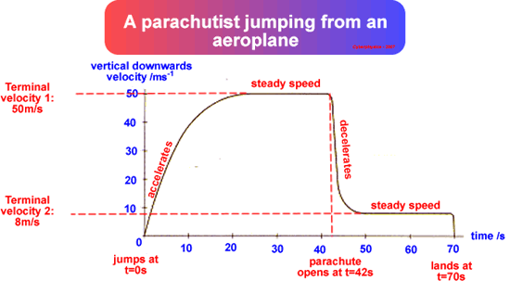
When the forces acting on him are __________ he has reached a constant speed called his ______________ __________________.
When he opens his parachute the ________ ________________ increases. As his __________ has stayed the same there is an _____________ force acting on him to slow him down. As he slows down the air resistance decrease until it is ___________ ____ his weight. The forces on him are again ____________.
He steps out of the plane and starts to fall.
The only force acting on him is ______________.
As he falls he ________ up. This causes the _____ ______________ to increase. This keeps on happening until the ______ _________________ is equal to his ____________.
When the forces acting on him are balanced he has reached a new ___________ terminal velocity.
When he reaches the ground he should come to a safe stop.
When the speed of something moving through air __________ the air resistance ____________.
When the speed of something moving through air _______________ the air resistance ________________.

Slide 6
The energy transfer in a light bulb is
__________ ___________ + __________
Energy comes in several different types
_______________________________________________________________________________________________________________________________________________________
CONSERVATION OF ENERGY
Power is how much _______
Is used per ___________
Energy can not be __________ or _______________ only changed from one type to another.
The equation for this is
___________________
The energy something has because it is moving is called ________ energy.
When a ___________ is applied to move something then we say __________ has been done on it.
The energy something has because it has been raised up is called
_____________________ energy.
The equation for this is
___________________
The equation for this is
___________________
The equation for this is
___________________
When you apply a force to raise an object up a distance _________ is done to the object . This energy is stored as________________________. When you drop the object this energy is all changed into ________________ if we ignore____________.
If we don’t ignore _____ _______________. Then some energy is changed to ________ energy.

