Slide 1
Edexcel P2 Motion, Work done, Electricity and Nuclear Physics
Pre exam presentation
By Mr Baker

Slide 2
Units!
You need to know the units for each value (or ANY equation): some tricky ones!
Acceleration – m/s² (meters per second per second)
Force and weight – N (newtons)
Mass – kg (kilograms)
Resistance – Ω (ohms)
Potential difference – V (volts)
Current – A (amps or amperes)
Energy (of any type including work done) – J (joules)
Power – W (watts, i.e. joules per second)
Charge – C (coulombs)

Slide 3
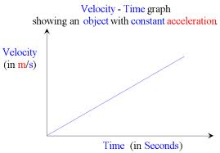
Acceleration
You should be able to calculate the acceleration of an object from its change in velocity and the time taken.
change in velocity (m/s)
Acceleration (m/s²) = -----------------------------------
time taken (s)
v (m/s)
acc (m/s²) = -----------------
t (s)

Slide 4

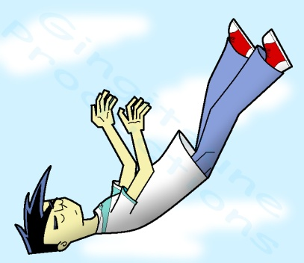
Force and weight
g = 10 N/kg
Force (N) = Mass (kg) x Acceleration (m/s²)
F = m x a
If the force is weight then use W instead and g for gravitational field strength instead of Acc (which is always 10 N/kg)
Weight (N) = Mass (kg) x Gravitation field strength (N/kg)
W = m x g
Remember! Weight is a force and so it’s units are newtons (mass is measured in kilograms).

Slide 5
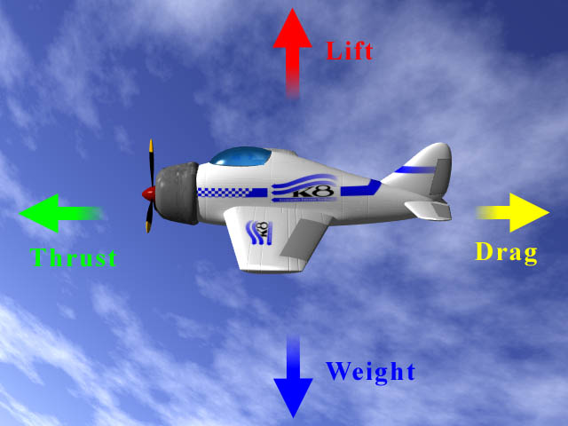
Equal and opposite
Remember Newton’s 3rd law:
Every force causes an equal and opposite force.
So you sitting on a chair stationary or walking at a constant speed means there is equilibrium, the forces in one direction are equal to those in the opposite direction. (Resultant force = 0 newtons)

Slide 6
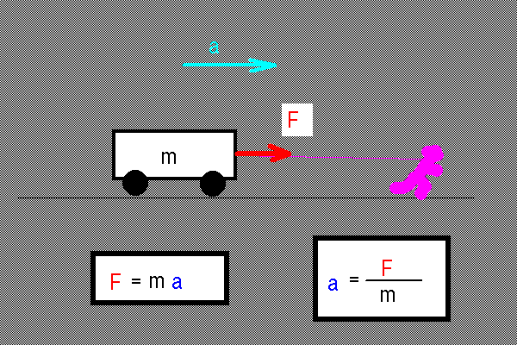
Resultant forces mean changes
Do NOT say that force make things ‘move’.
That is not enough detail.
A resultant force causes and object speed up, slow down or change direction.
Try to use the key words:
Accelerate
Decelerate
Constant velocity

Slide 7
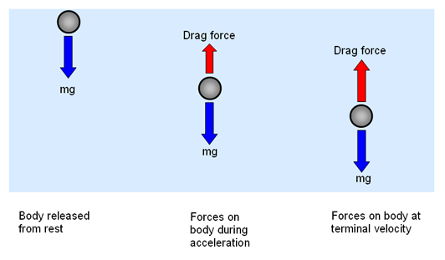
Four Typical Forces That I Could Be Asked about
Air resistance - drag
  When an object moves through the air, the force of air resistance acts in the opposite direction to the motion. Air resistance depends on the shape of the object and its speed.
Friction
  This is the force
  that resists movement
  between two surfaces
  which are in contact.
W=
W=
W=

Slide 8
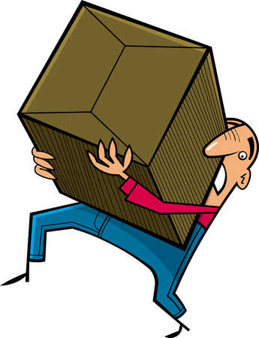
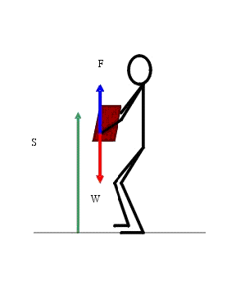
Work done
Work done = energy transferred
So in the case of an object being moved through a distance: f x d
Work done = force x distance
If the object is being lifted the
to lift the object will equal to its
weight.
Lifting force, f
Distance (height)
d or h
Don’t forget to change mass (kg) into weight (N) using W = m x g
W

Slide 9
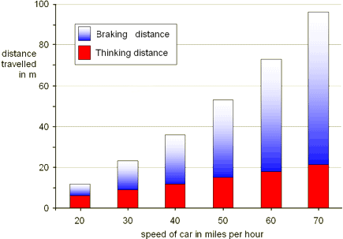
Stopping Distance
The stopping distance is the thinking distance added to the braking distance. The graph shows some typical stopping distances.

Slide 10
Static Electricity
Some insulating materials become electrically charged when they are rubbed together.
Charges that are the same repel, while unlike charges attract.
Paint sprayers are a typical use of electrostatics…however
You could be given a situation/use that describes where like and unlike charges are in use with a task to explain how these properties help.

Slide 11
Moving Charges
When you rub two different insulating materials against each other they become electrically charged.
This only works for insulated objects - conductors lose the charge to earth.
When the materials like insulators are rubbed against each other:
1- negatively charged particles called electrons move from one material to the other
2- the material that loses electrons becomes positively charged
3- the material that gains electrons becomes negatively charged
4- both materials gain an equal amount of charge, but the charges are opposite

Slide 12
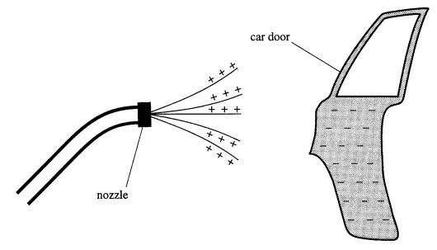
Paint sprayer use
Remember there are 2 parts:
Sprayer – charged paint droplets repel each other creating a thin, evenly spread mist.
Object – the object (i.e. car door, bicycle, e.g.) has the opposite charge so that the paint is attracted to
it, this produces an
even layer and stops
paint being wasted
(and also breathed in,
i.e. safer).

Slide 13
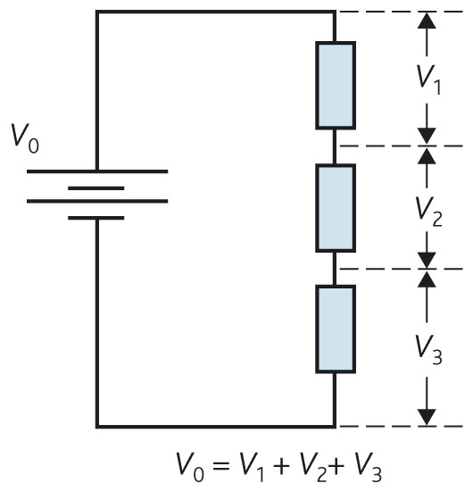
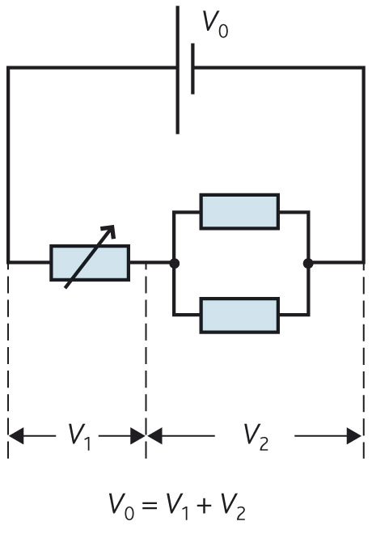
How potential difference is distributed
Series
Parallel
Notes:
Voltage in series is divided between components summing to the potential difference across the power supply.
Voltage for components in parallel is the same.

Slide 14
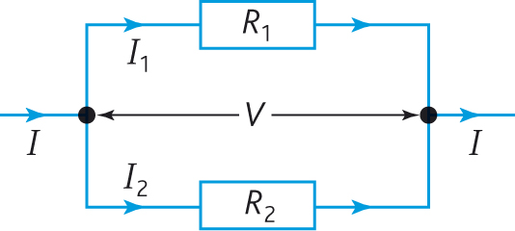
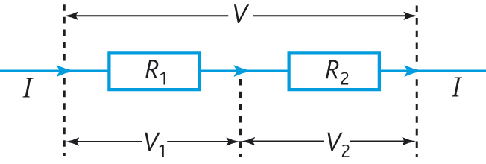
How current flows
Current ‘flows’ through components.
If there is a junction, the current (I) will divide (not normally equally) into I1 and I2.
It then combines back at the next junction.
Parallel
Series
If there is no junction, the current remain the same through all components.

Slide 15

The Thermistor
Thermistors are used as temperature sensors - for example, in fire alarms.
Their resistance decreases as the temperature increases:
- At low temperatures, the resistance of a thermistor is high and little current can flow through them.
- At high temperatures, the resistance of a thermistor is low and more current can flow through them.
A Thermistor

Slide 16

The LDR
LDRs (light-dependent resistors) are used to detect light levels, for example, in automatic security lights.
Their resistance decreases as the light intensity increases:
- In the dark and at low light levels, the resistance of an LDR is high and little current can flow through it.
- In bright light, the resistance of an LDR is low and more current can flow through it.
Light Dependant Resistor (LDR)

Slide 17
Units!
You need to know the units for each value (or ANY equation): some tricky ones!
Acceleration – m/s² (meters per second per second)
Force and weight – N (newtons)
Mass – kg (kilograms)
Resistance – Ω (ohms)
Potential difference – V (volts)
Current – A (amps or amperes)
Energy (of any type including work done) – J (joules)
Power – W (watts, i.e. joules per second)
Charge – C (coulombs)

Slide 18
Nuclear glossary
alpha radiation – Positively charged particles made up of two protons and two neutrons.
background radiation – Constant low-level radiation from food and environmental sources.
beta radiation – High-energy electrons emitted by some radioactive materials.
gamma radiation – Short-wavelength electromagnetic radiation emitted during radioactive decay.
Geiger-Müller tube – A device used to detect and measure radiation from radioactive materials.
ionizing radiation – High-energy radiation capable of ionizing substances through which it passes.
radioactivity – The spontaneous emission of radiation from the nucleus of an unstable atom.

Slide 19
Nuclear characteristics
Particles | Symbol | Structure | Relative charge | Penetrating | Stopped by
Alpha | α | Helium nucleus 2x neutron 2x proton | +2 | The least | Paper 10cm – 1m of air
Beta | β | Electron (high speed) | -1 | A lot | Aluminium 10m of air
Gamma | ɣ | Light ray (EM radiation) | 0 | The most | Lead Not stopped by air 30cm of concrete

Slide 20
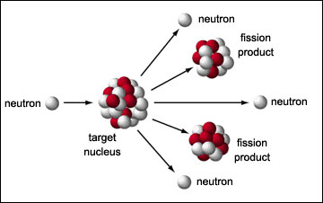
Nuclear fission
A fission event is the process of a neutron colliding and joining with a massive nucleus (like Uranium or Plutonium), causing it to split apart and realise more ‘fission neutrons’.
A chain reaction is
started as the
neutrons collide with
more nuclei causing
them to split
releasing more
fission neutrons and
so on.

Slide 21
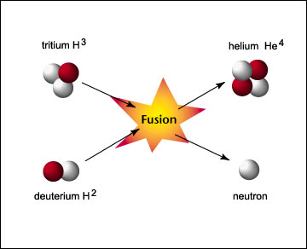
Nuclear fusion
Fusion (think ‘fuse’) is the process of tiny nuclei colliding at high speed (high temperature) and fusing together.
1) At first two protons
fuse, they form a
‘heavy hydrogen’
nucleus. Another
proton collides to
make a heavier nuclei.
2) Two of these heavier nuclei collide to form a helium nucleus.
3) The energy released at each stage is carried away as kinetic energy of the product nucleus and other particles emitted.
ENERGY

Slide 22
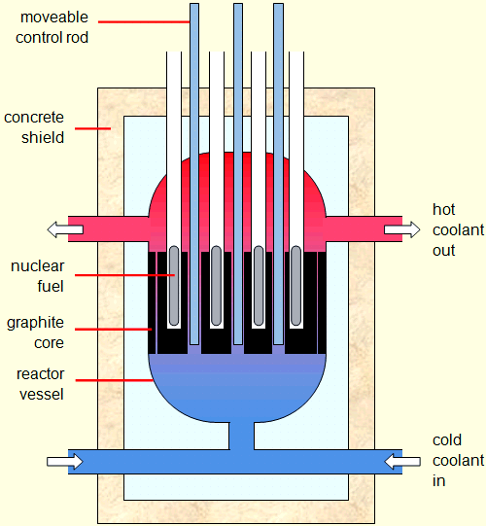
Nuclear reactors
Structure:
Most commonly they ask about control rods.
Rods that absorb neutrons increasing or decreasing (controlling) the reaction.
Also, the coolant cycling around to carry (useful) thermal energy away and the shielding to insulate radiation.

Slide 23
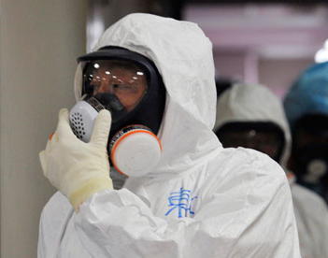
Nuclear reactors
Safety:
Nuclear power produces
Dangerous radiation both
when useful and the waste
left afterwards.
Students frequently refer to
protective gear needing to be worn when asked about waste and safety HOWEVER this is only one area of importance.
THERE ARE DANGERS AND SAFETY POINTS YOU CAN DISCUSS!

Slide 24
Risks
Safety precautions
• fuel rods have high temperature when removed from reactor
• protective clothing and handling systems should be used
• different types of ionising radiation produce different dangers
• minimise exposure to the ionising radiation
• energy from the ionising radiation can be absorbed by the human body
• intensity of radiation decreases with distance from the source
• (prolonged) exposure to radiation can cause {tissue / cell} damage and {mutation/ damage to DNA}
• personal radiation dose should be monitored
• increased risk due to long term exposure to raised background levels of radiation
• monitoring of background levels of radiation
• leak from {reactor / rods / reprocessing unit }
• use of canister to carry fuel rods

