Slide 1
Aromatic Compounds
Phenol Chemistry

Slide 2
Syllabus Says...
Phenols
(f) describe the reactions of phenol:
(i) with aqueous alkalis and with sodium to
form salts,
(ii) with bromine to form 2,4,6-tribromophenol;
(g) explain the relative ease of bromination of phenol
compared with benzene, in terms of electron-pair
donation to the benzene ring from an oxygen porbital
in phenol;
(h) state the uses of phenols in production of
plastics, antiseptics, disinfectants and resins for
paints.

Slide 3


Pure phenol is a white crystalline solid, smelling of disinfectant. It has to be handled with great care because it causes immediate white blistering to the skin. The crystals are often rather wet and discoloured.
If the OH group (hydroxy) is directly attached to a benzene ring, the molecule is classified as a 'phenol'.
If not, the molecule is classified as an aliphatic alcohol.
This difference is illustrated below with molecules containing a benzene ring (Phenols ROH, R=aryl only)

Slide 4
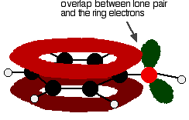
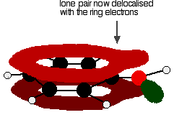
Properties
There is an interaction between the delocalised electrons in the benzene ring and one of the lone pairs on the oxygen atom
This has an important effect on both the properties of the ring and of the -OH group.
One of the lone pairs on the oxygen overlaps with the delocalised ring electron system . . .
. . giving a structure rather like this:

Slide 5
The donation of the oxygen's lone pair into the ring system increases the electron density around the ring
That makes the ring much more reactive than it is in benzene itself.
It also helps to make the -OH group's hydrogen a lot more acidic than it is in alcohols
Consider.....
                melting point (°C) boiling point (°C)
            C₆H₅OH 40 - 43 182
            C₆H₅CH₃ -95.0 111
            Both molecules contain the same number of electrons and are a very similar shape. That means that the intermolecular attractions due to van der Waals dispersion forces are going to be very similar
The reason for the higher values for phenol is in part due to permanent dipole-dipole attractions due to the electronegativity of the oxygen - but is mainly due to hydrogen bonding.
Hydrogen bonds can form between a lone pair on an oxygen on one molecule and the hydrogen on the -OH group of one of its neighbours

Slide 6
How does the -OH group modify the ring reactions?
Activation of the ring
The -OH group attached to the benzene ring in phenol has the effect of making the ring much more reactive than it would otherwise be.
For example, as you will find below, phenol will react with a solution of bromine in water (bromine water) in the cold and in the absence of any catalyst. It also reacts with dilute nitric acid, whereas benzene itself needs a nitrating mixture of concentrated nitric acid and concentrated sulphuric acid.
One of the lone pairs on the oxygen atom in the -OH group overlaps with the delocalised ring electron system giving a structure rather like this:
The donation of the oxygen's lone pair into the ring system increases the electron density around the ring.
A benzene ring undergoes substitution reactions in which the ring electrons are attacked by positive ions or the slightly positive parts of molecules. In other words, it undergoes electrophilic substitution. If you increase the electron density around the ring, it becomes even more attractive to incoming electrophiles. That's what happens in phenol

Slide 7


Why is phenol acidic?
Phenol is sufficiently acidic for it to have recognisably acidic properties - even if it is still a very weak acid
A hydrogen ion can break away from the -OH group and transfer to a base.
For example, in solution in water:
Properties of phenol as an acid
With sodium hydroxide solution
Phenol reacts with sodium hydroxide solution to give a colourless solution containing sodium phenoxide.
In this reaction, the hydrogen ion has been removed by the strongly basic hydroxide ion in the sodium hydroxide solution

Slide 8

With metallic sodium
Acids react with the more reactive metals to give hydrogen gas. Phenol is no exception - the only difference is the slow reaction because phenol is such a weak acid.
Phenol is warmed in a dry tube until it is molten, and a small piece of sodium added. There is some fizzing as hydrogen gas is given off. The mixture left in the tube will contain sodium phenoxide

Slide 9
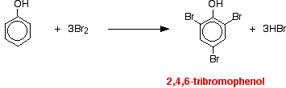
The directing effect of the -OH group
The -OH group has more activating effect on some positions around the ring than others. That means that incoming groups will go into some positions much faster than they will into others.
The net effect of this is that the -OH group has a 2,4-directing effect. That means that incoming groups will tend to go into the 2- position (next door to the -OH group) or the 4- position (opposite the -OH group). You will get hardly any of the 3- isomer formed - it is produced too slowly.
Reaction with bromine water
If bromine water is added to a solution of phenol in water, the bromine water is decolourised and a white precipitate is formed which smells of antiseptic.
The precipitate is 2,4,6-tribromophenol
Notice the multiple substitution around the ring - into all the activated positions. (The 6- position is, of course, just the same as the 2- position. Both are next door to the -OH group.)

Slide 10
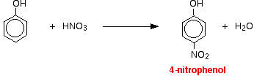

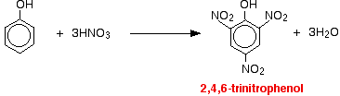
Reactions with nitric acid
The reactions with nitric acid are complicated because nitric acid is an oxidising agent, and phenol is very easily oxidised to give complex tarry products. What follows misses all that complication out, and just concentrates on the ring substitution which happens as well.
With dilute nitric acid
Phenol reacts with dilute nitric acid at room temperature to give a mixture of 2-nitrophenol and 4-nitrophenol.
With concentrated nitric acid
With concentrated nitric acid, more nitro groups substitute around the ring to give 2,4,6-trinitrophenol (old name: picric acid).

